Slide 1
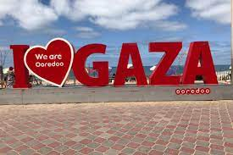
L'azione umanitaria a Gaza tra occupazione, blocco e de facto authority: l’esperienza di una operatrice umanitaria

Slide 2
L’azione umanitaria
Ha lo scopo di costruire spazi di normalità nel bel mezzo di una situazione profondamente anormale, in modo da permettere agli individui di riguadagnare i diritti e la dignità dovuti a tutti gli esseri umani.
4 Principi fondamentali che permettono di stabilire e mantenere l’accesso alle popolazioni in situazioni di crisi, specialmente in caso di conflitto
Humanity Neutrality Impartiality Independence
Il diritto umanitario internazionale (IHL) offre non solo il contesto giuridico per la protezione dei civili ma anche quello per le azioni di assistenza umanitaria.
Il rispetto del diritto umanitario garantisce lo Spazio Umanitario, che è quello in cui si muovono le ONG.

Slide 3
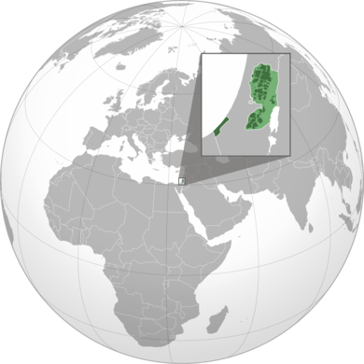
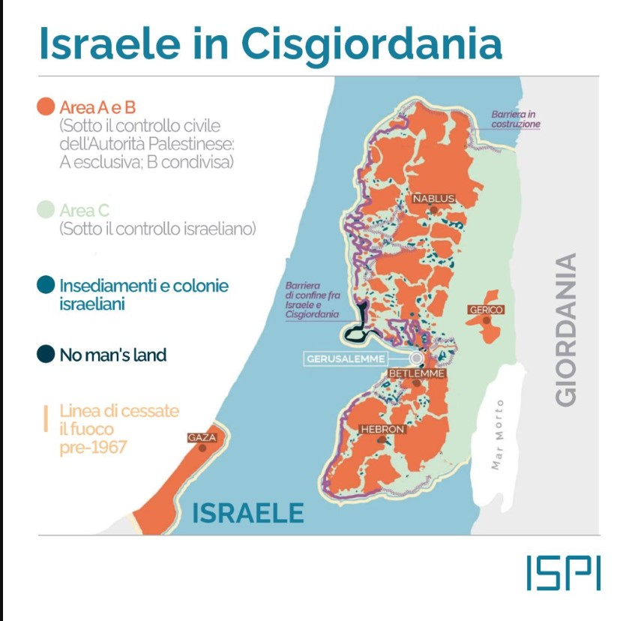
Gaza, Palestina
Uno Stato a riconoscimento limitato è uno Stato de facto indipendente e sovrano, che controlla e governa effettivamente un territorio e una popolazione, ma la cui sovranità è riconosciuta a livello internazionale solo da alcuni degli altri Stati.
Gaza Strip is a closed territory, and the freedom of individuals and goods is very limited, and it has been subjected to a series of brutal wars. As a result, the Gaza Strip has transformed from being a productive territory with an economic potential to a relief-based community that is surviving on international aid (Shaban, 2019).
Notes:
Palestina Stato di Palestina Autorità Palestinese
oPT, Territori palestinesi occupati
Territori contesi.
Molte definizioni per un solo popolo

Slide 4
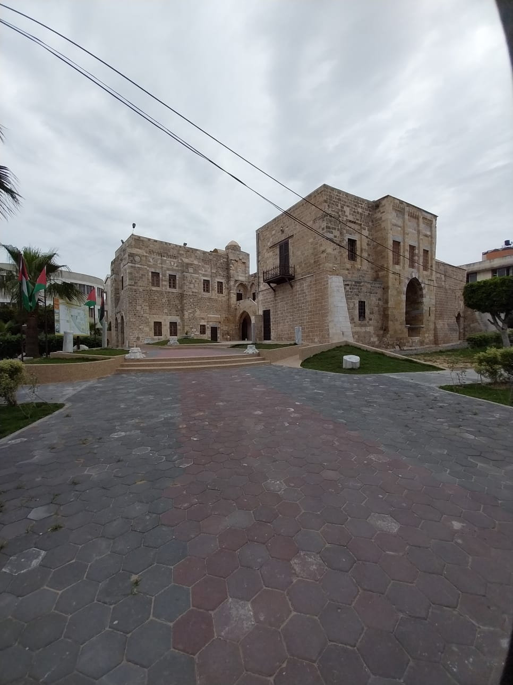
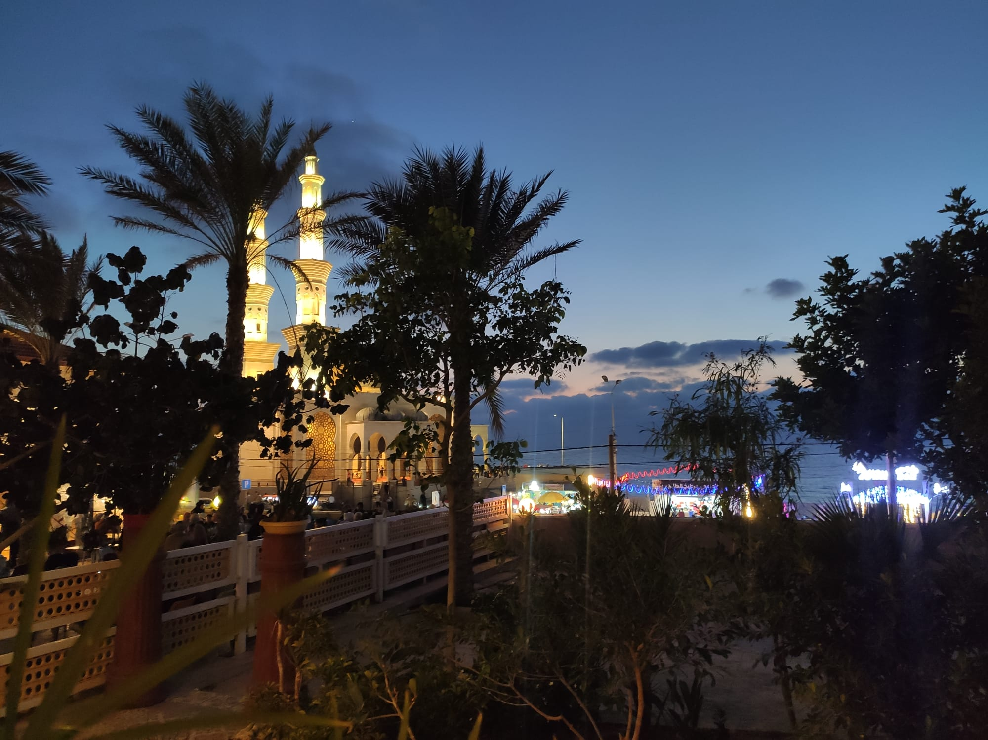
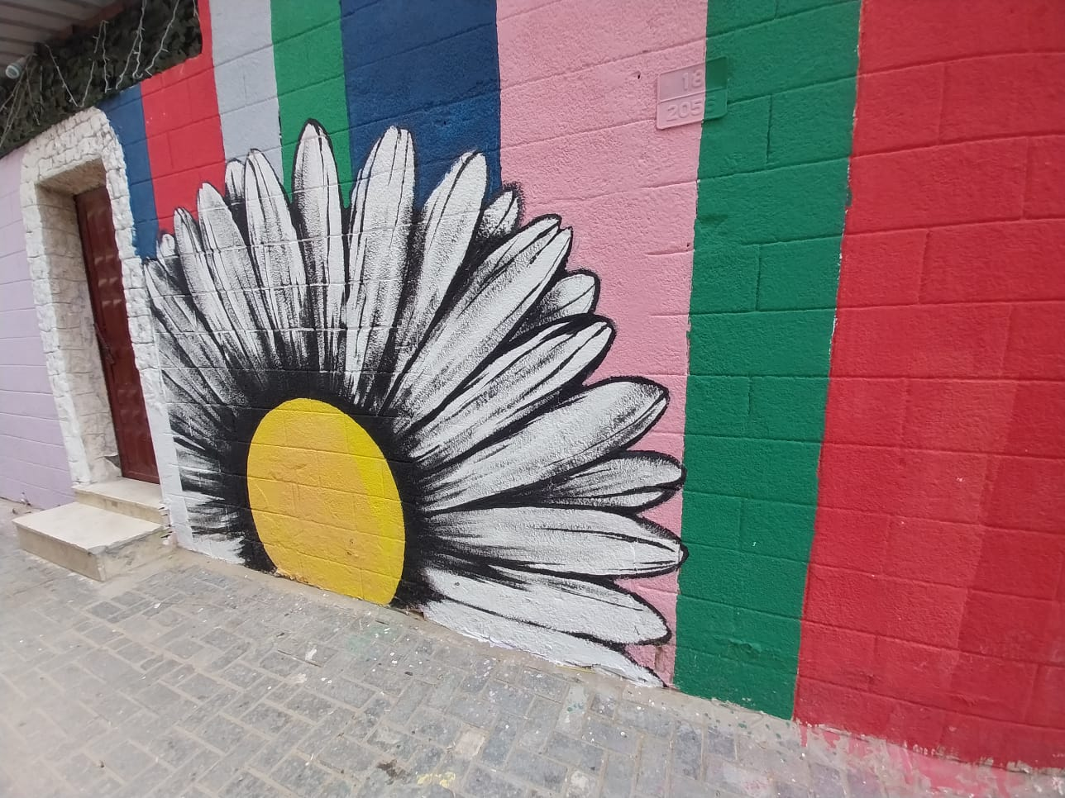
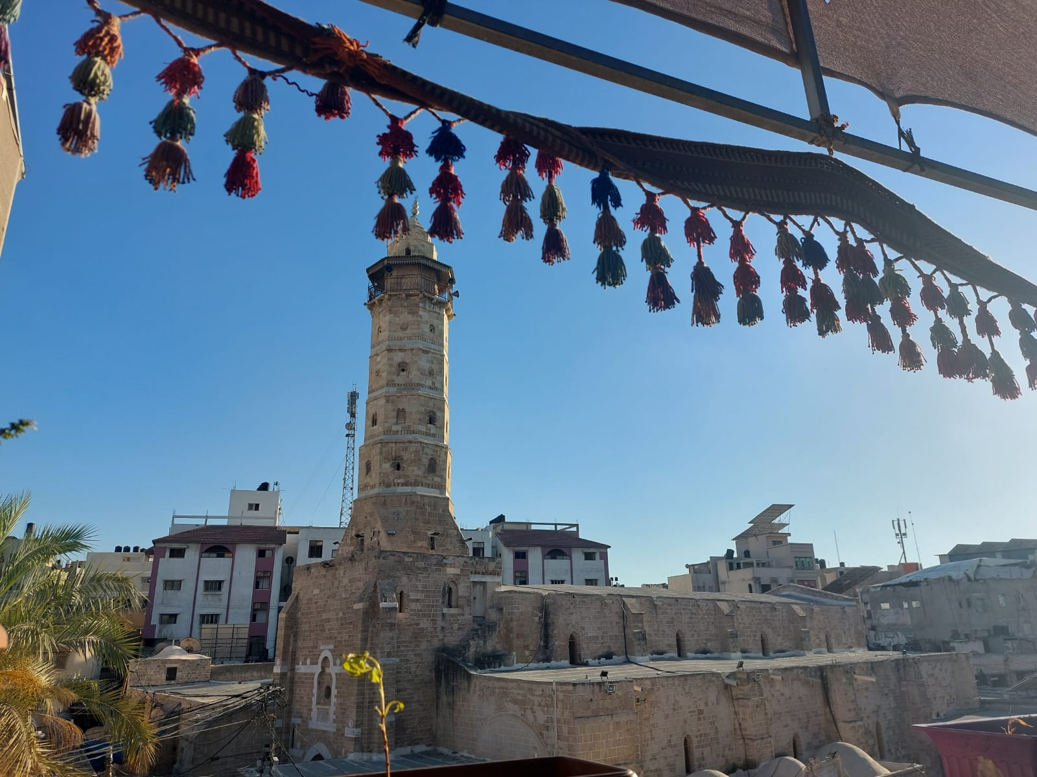
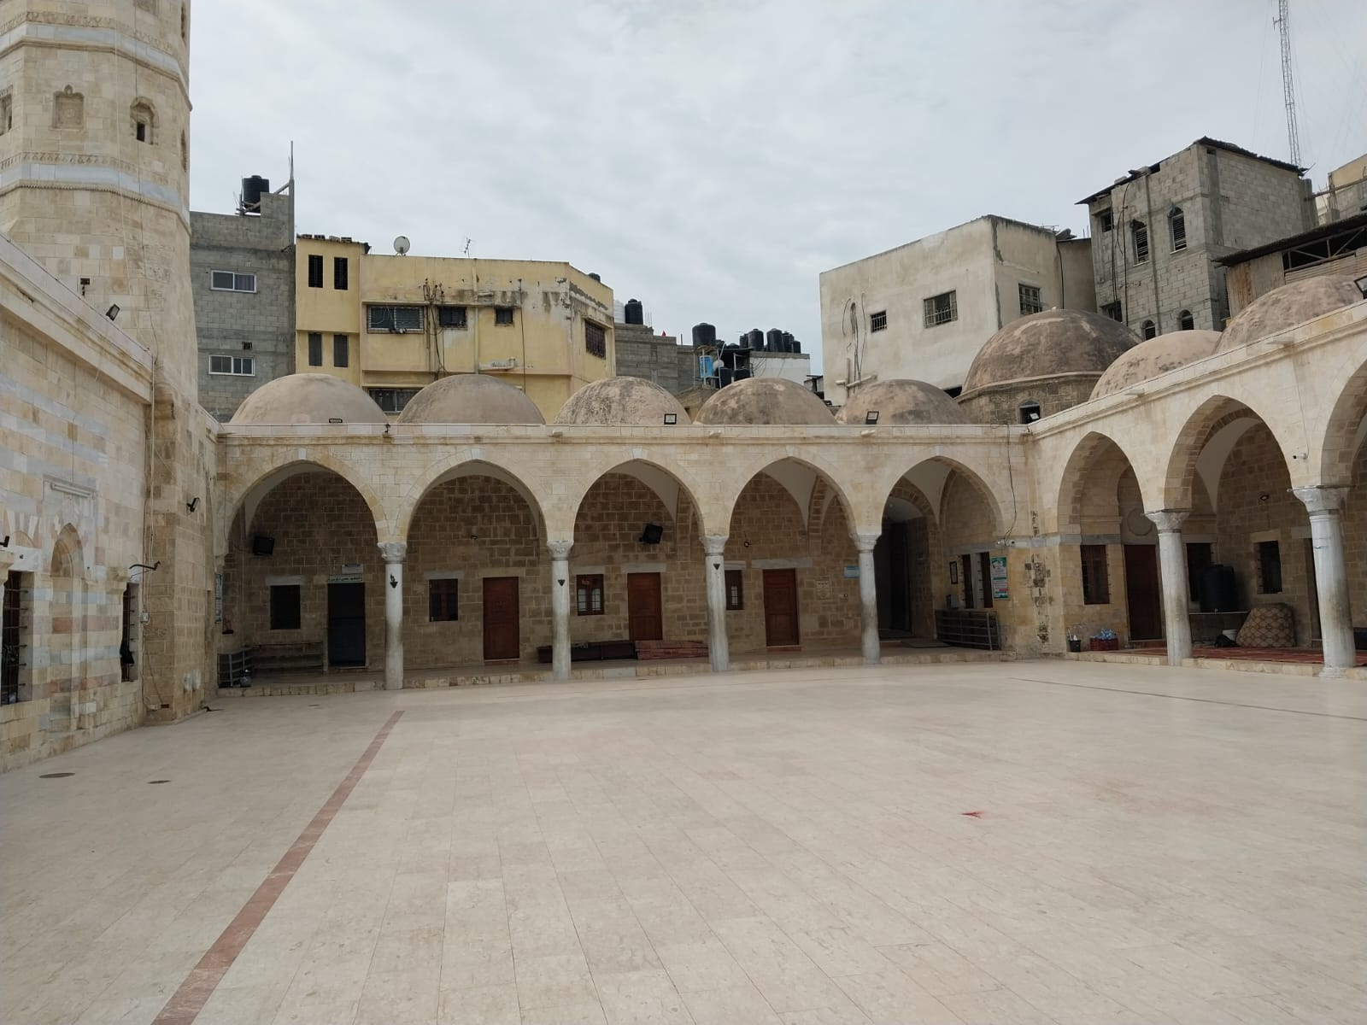
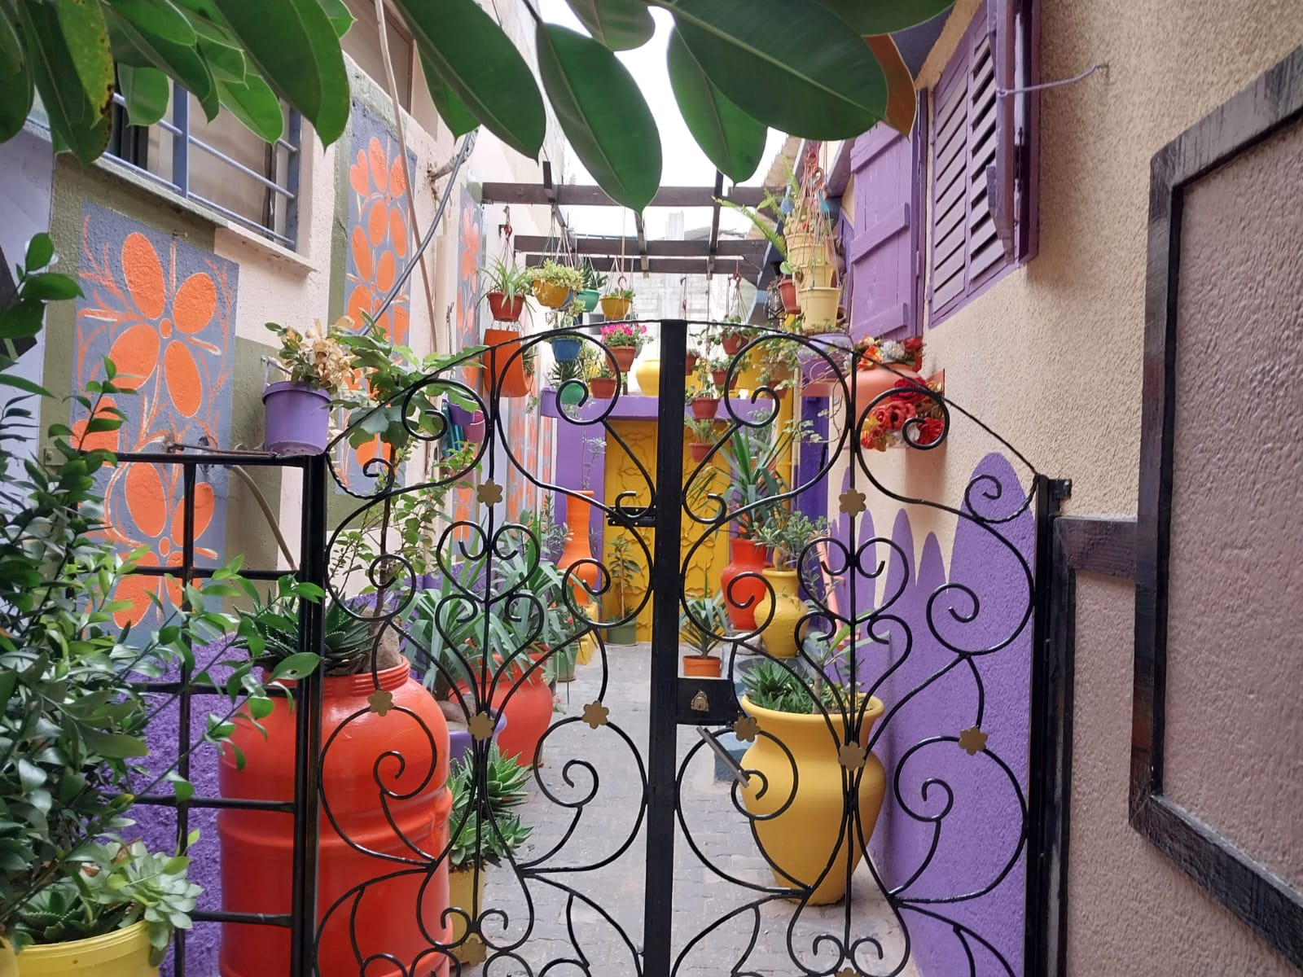
Gaza è bellezza

Slide 5
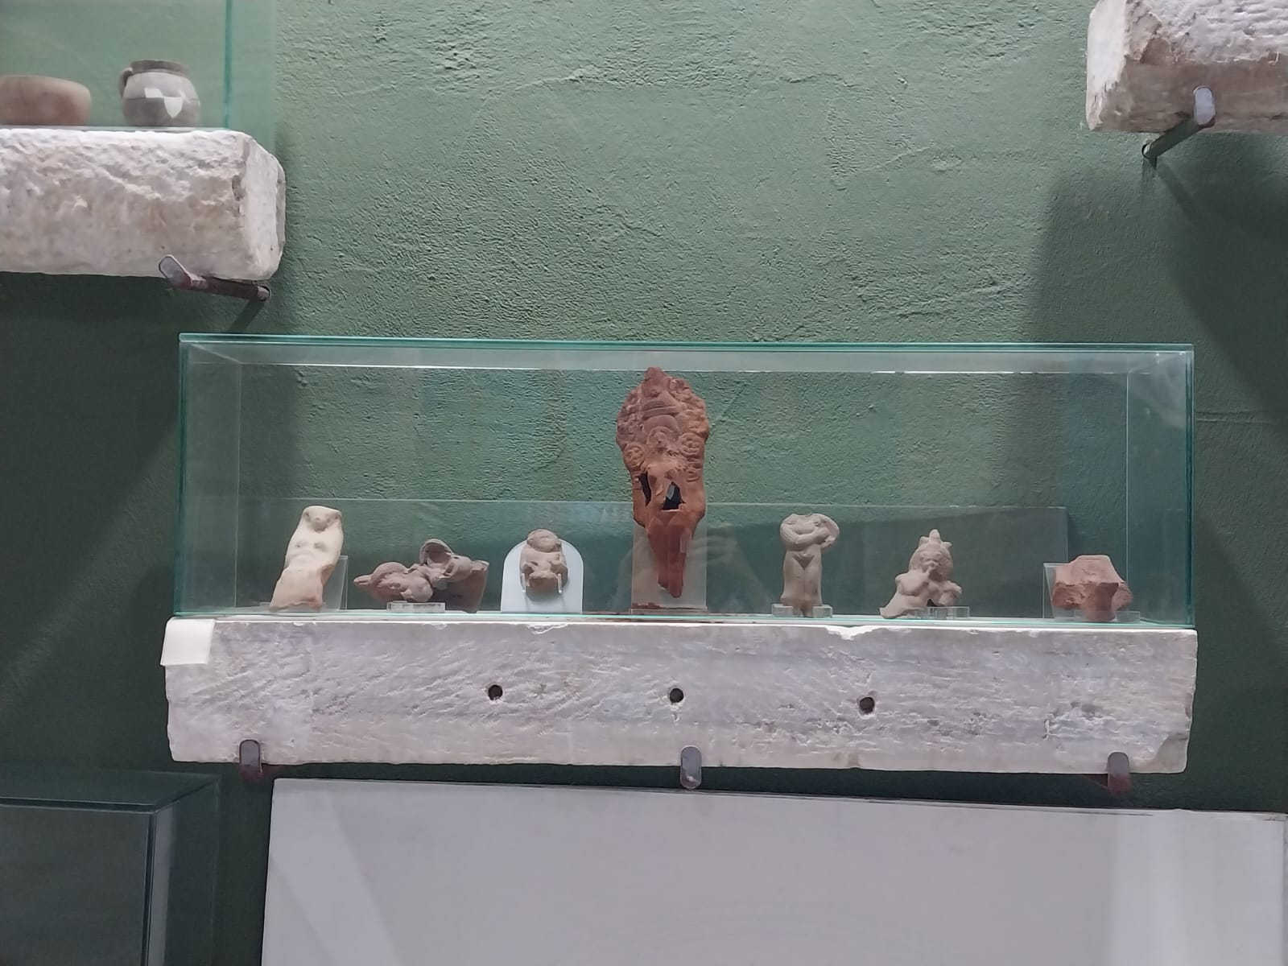
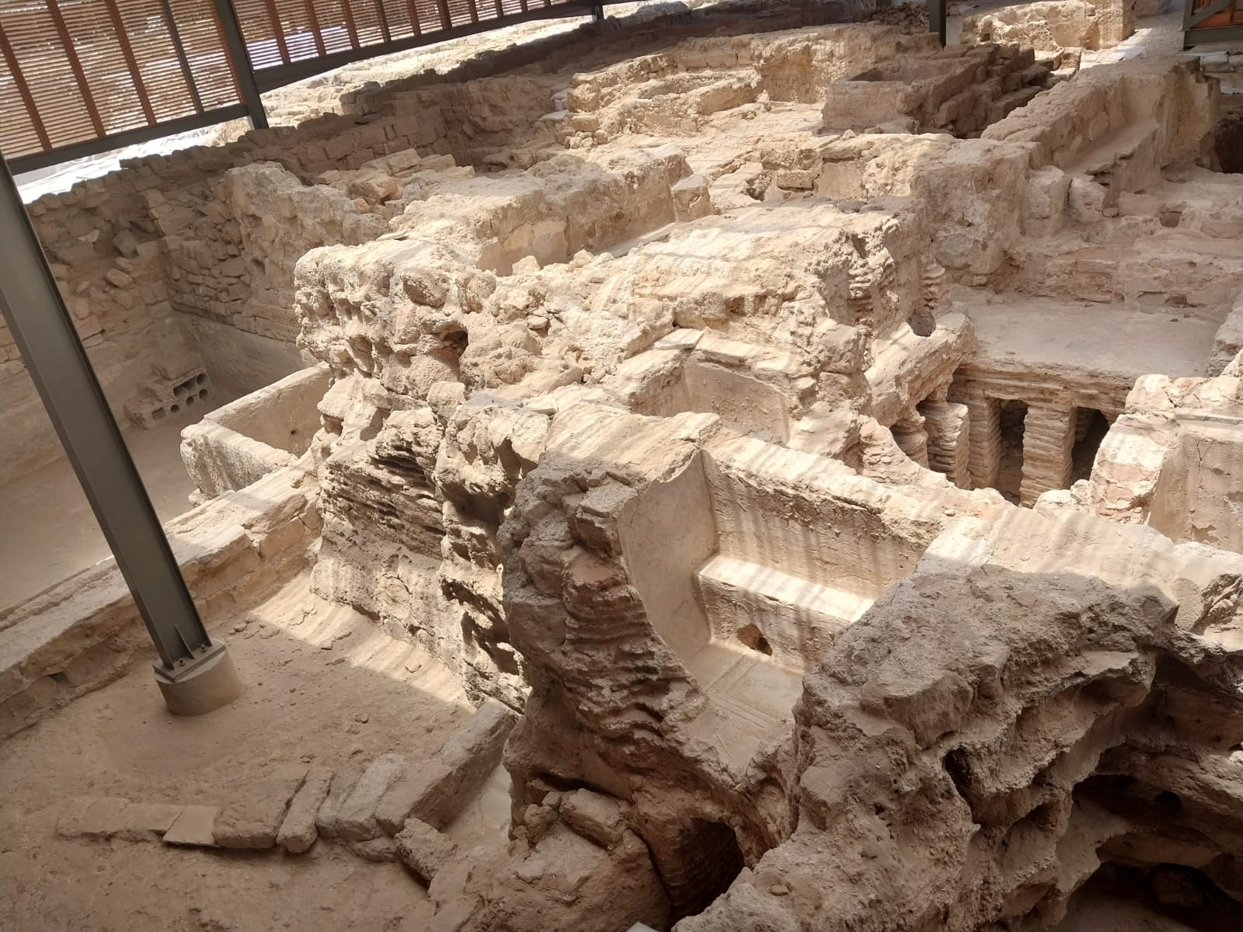
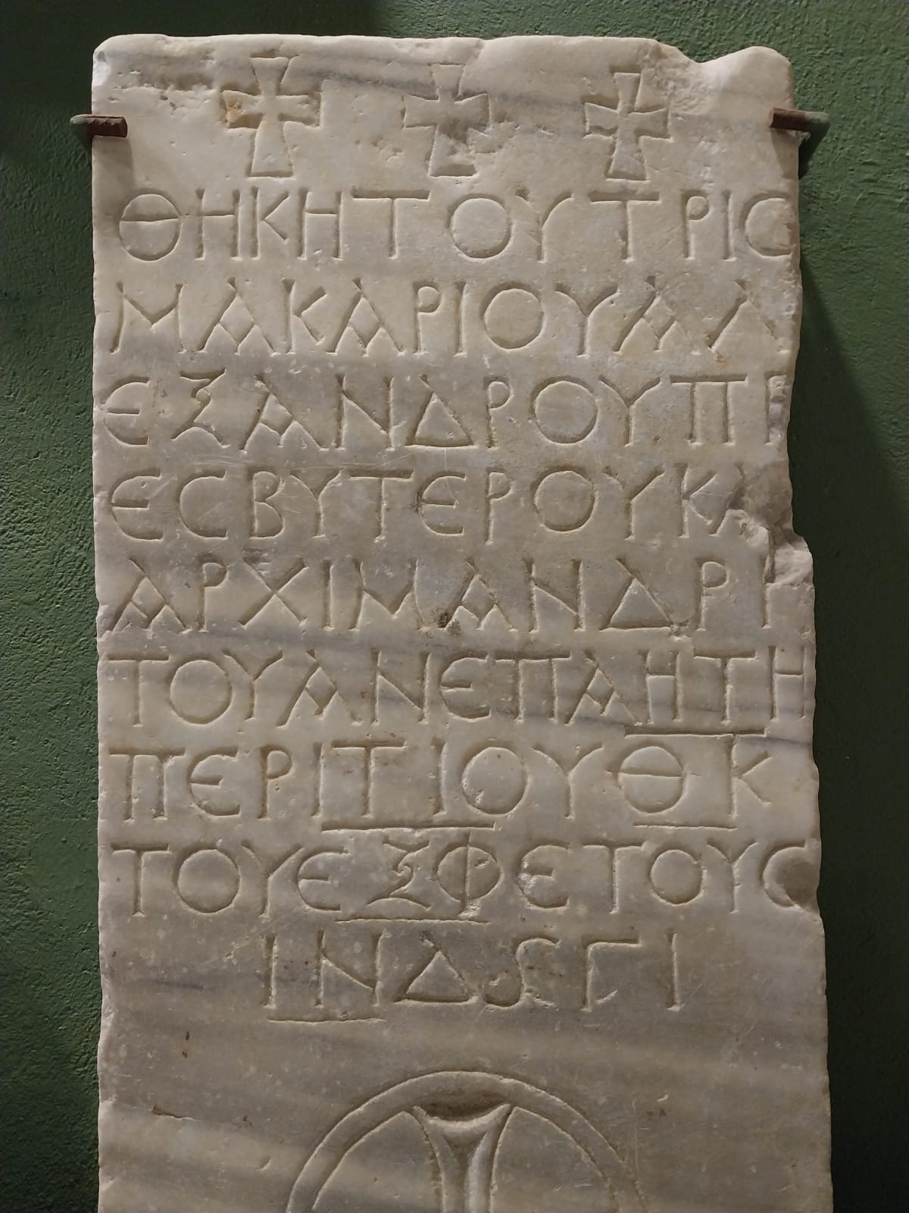
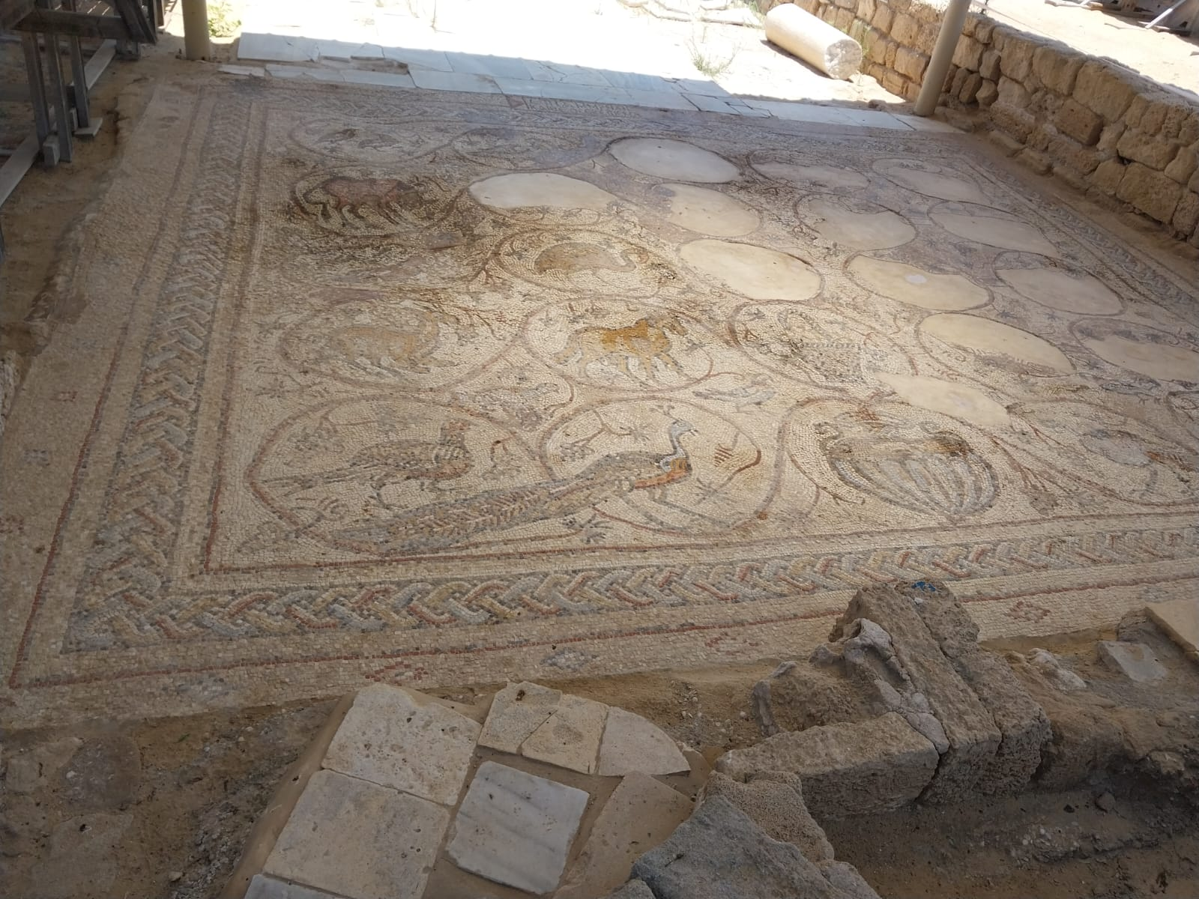
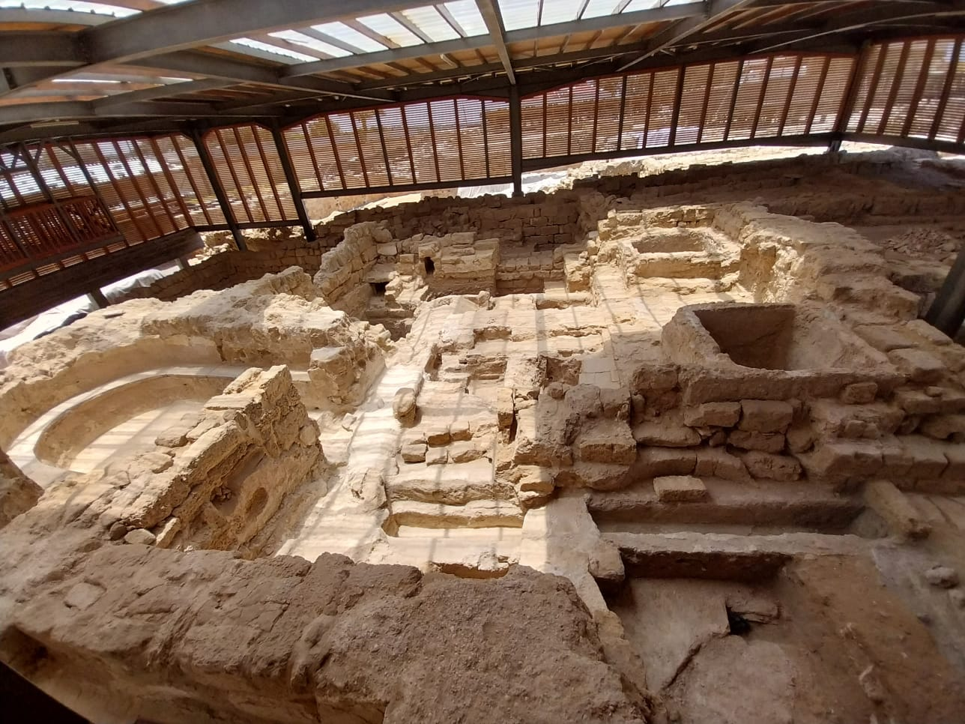
Gaza è storia

Slide 6
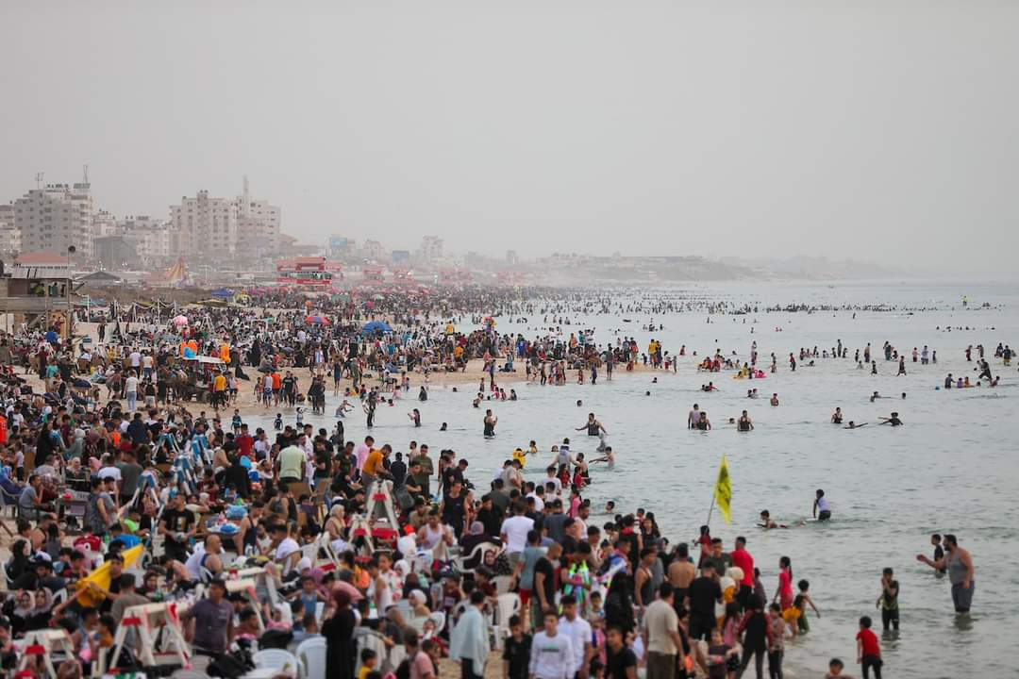
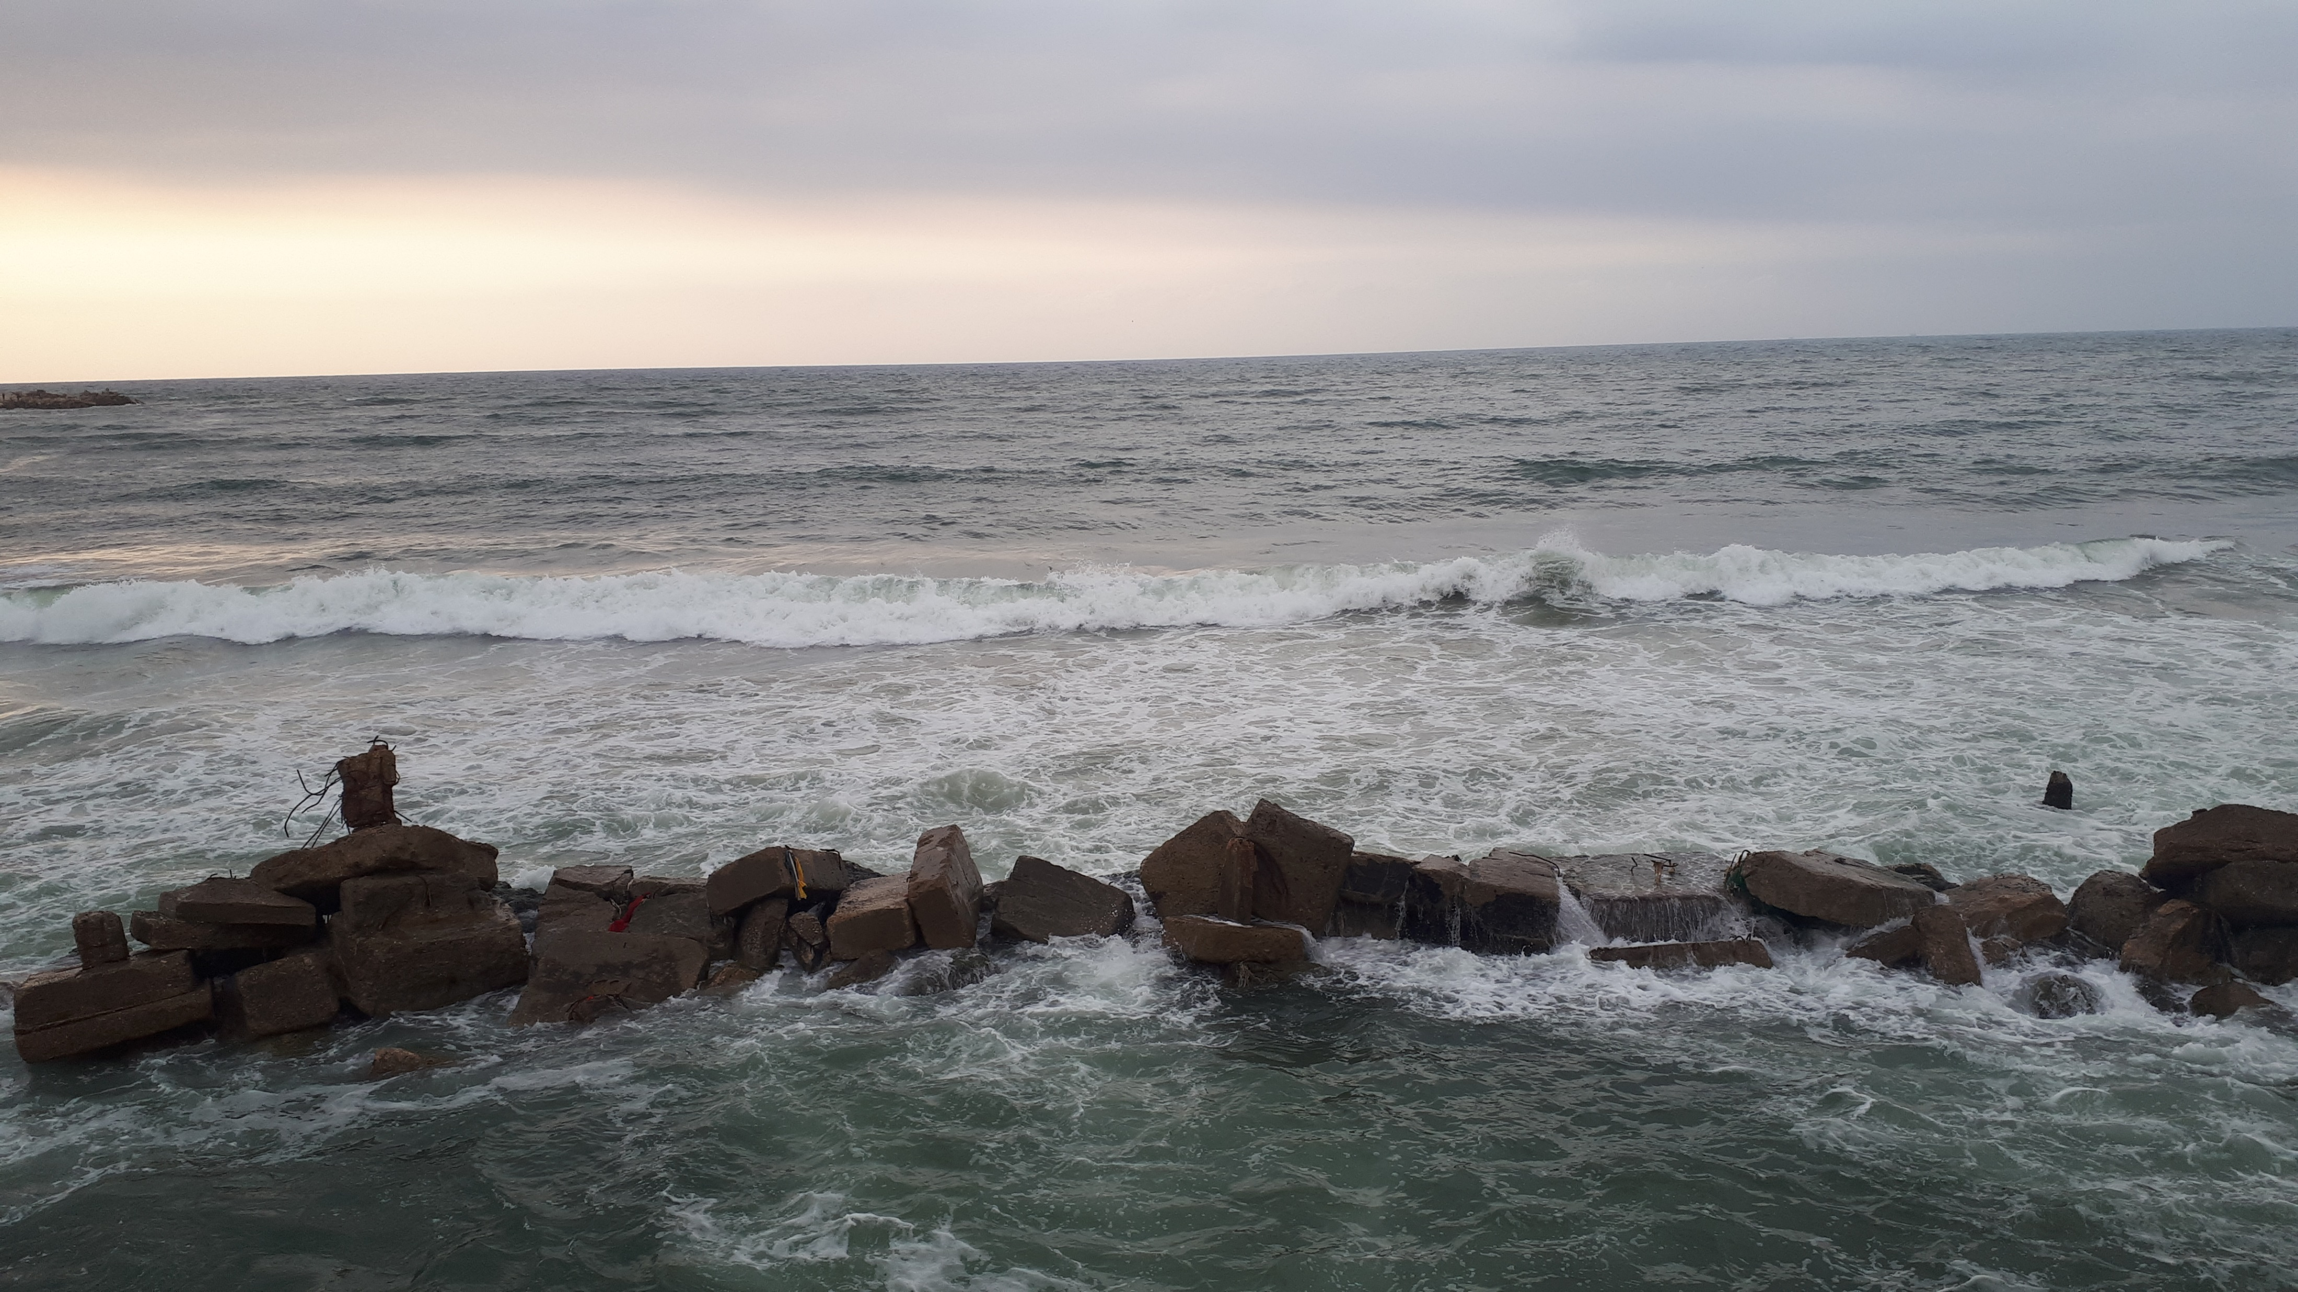
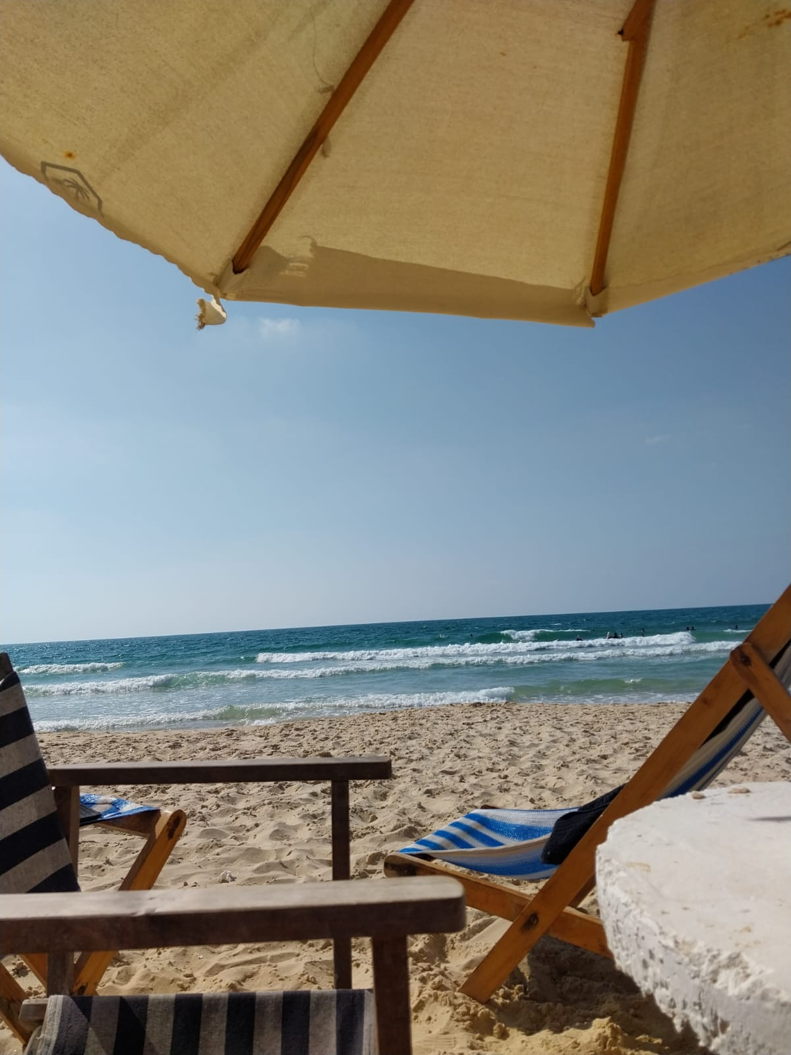
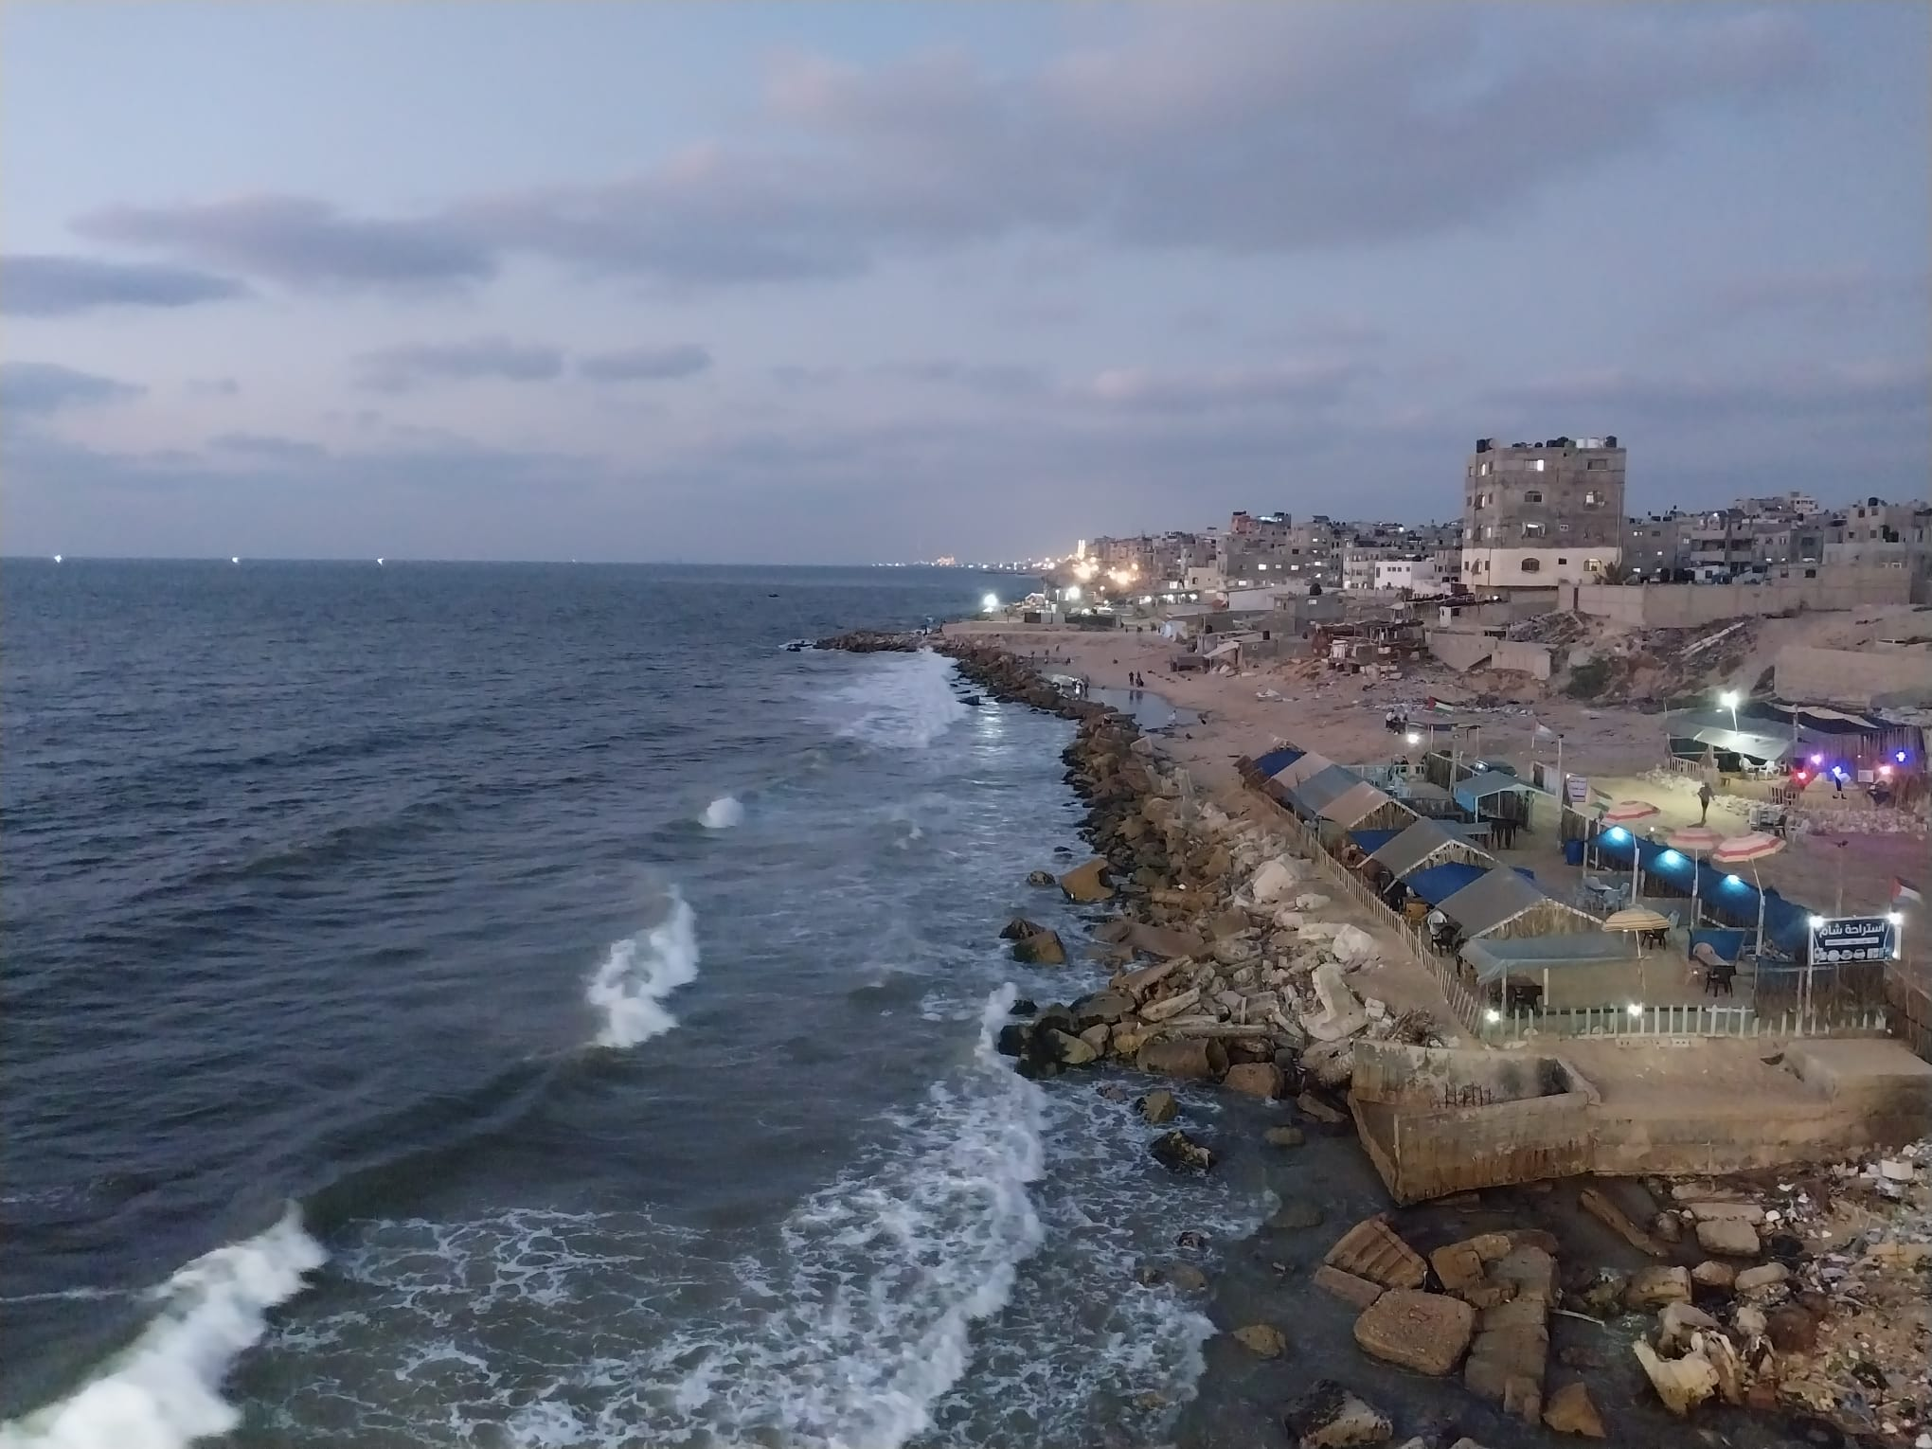
Gaza è mare

Slide 7
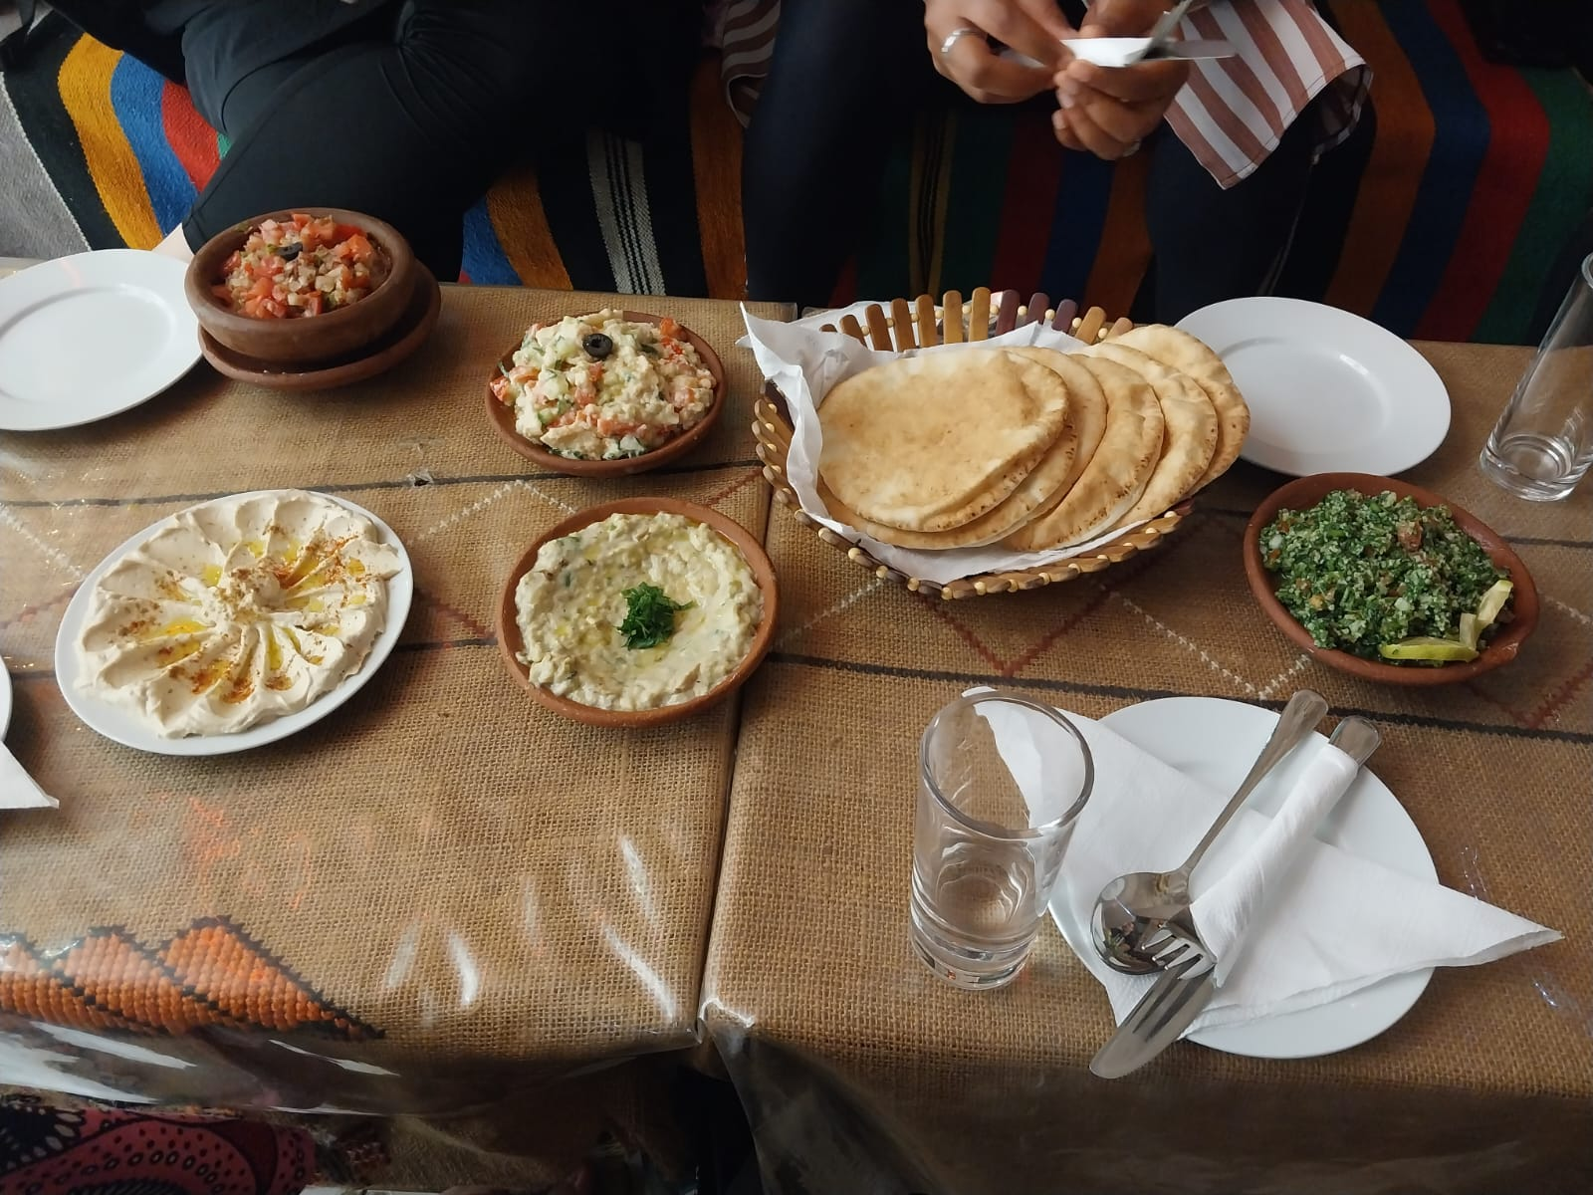
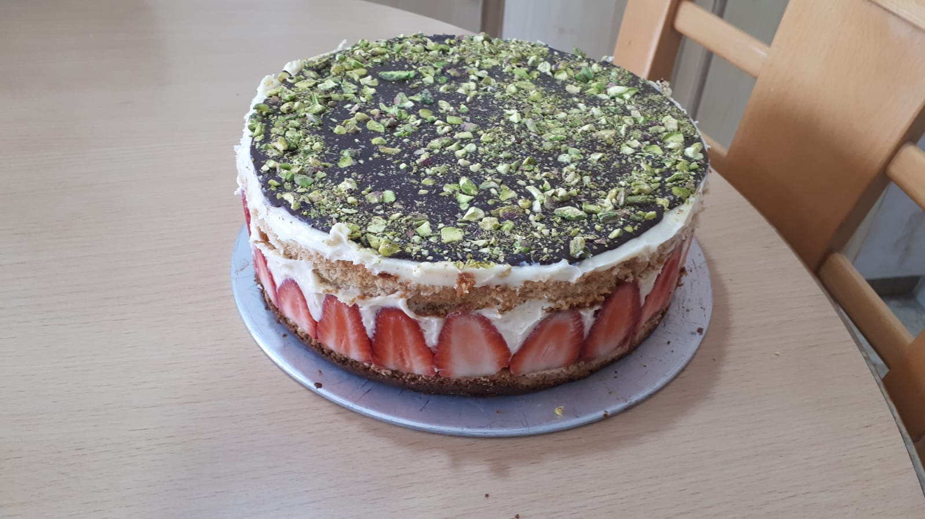
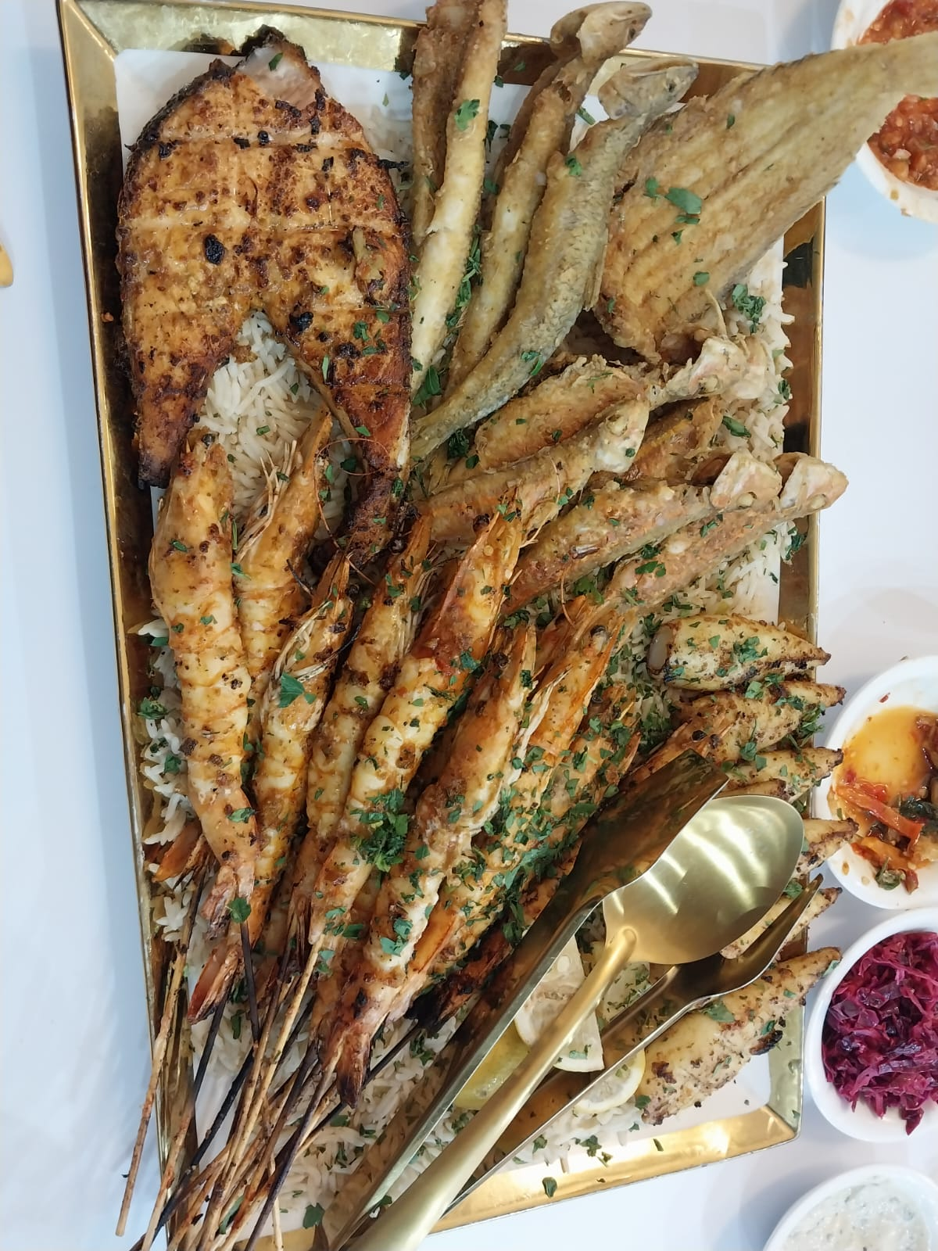
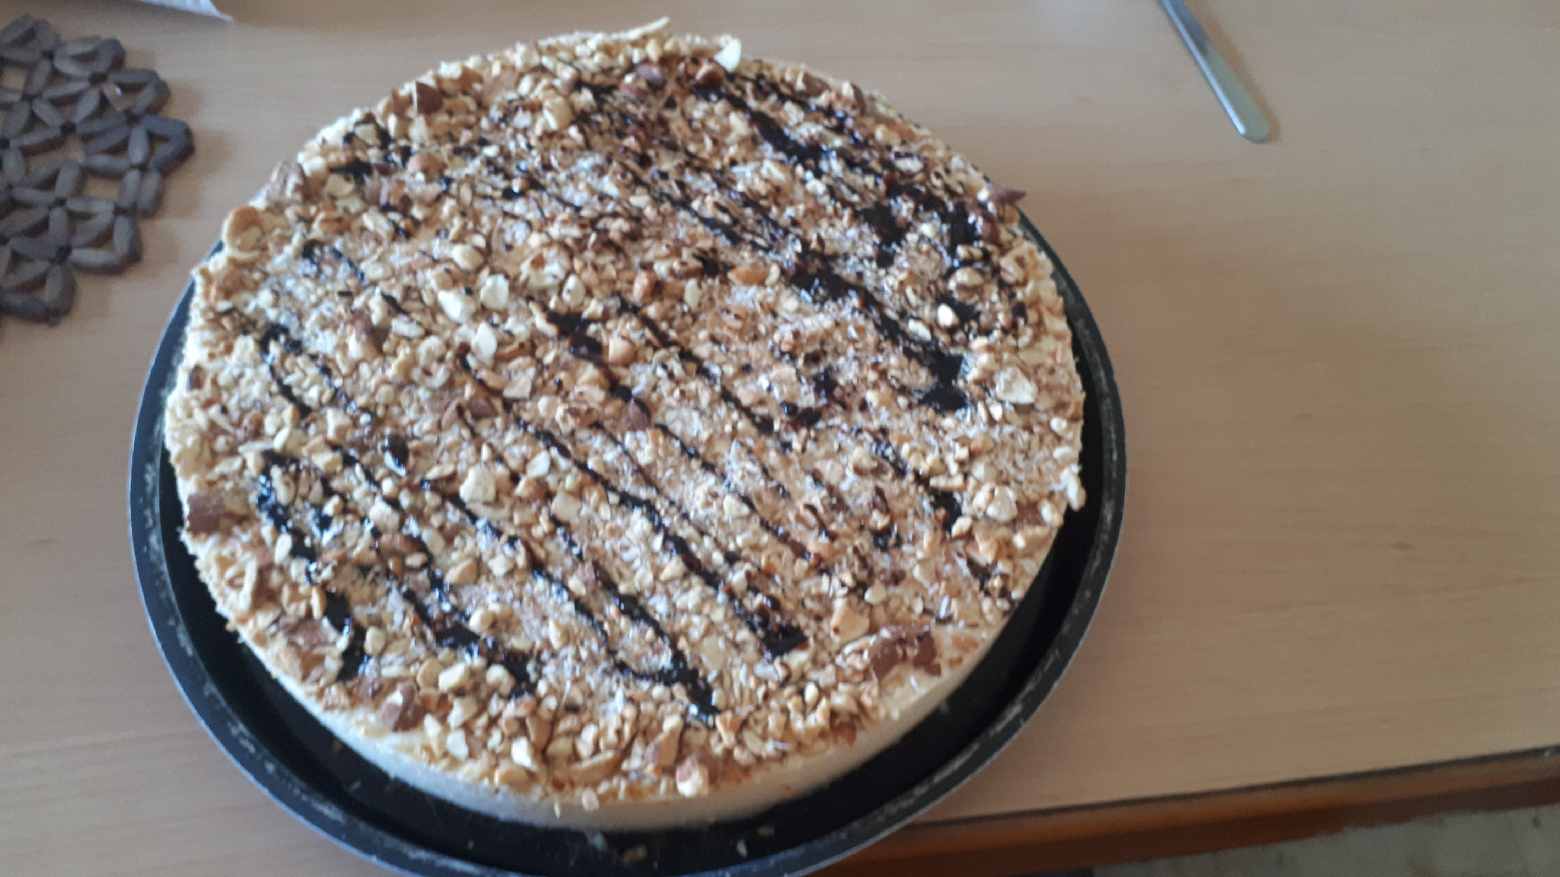
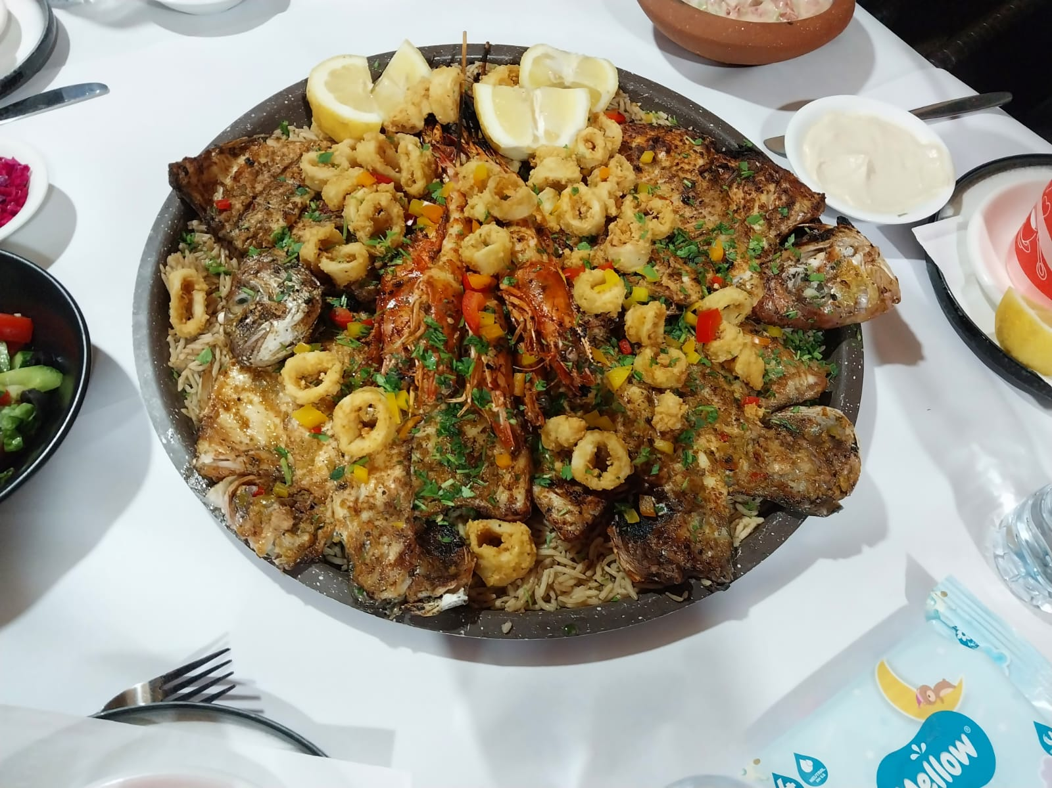
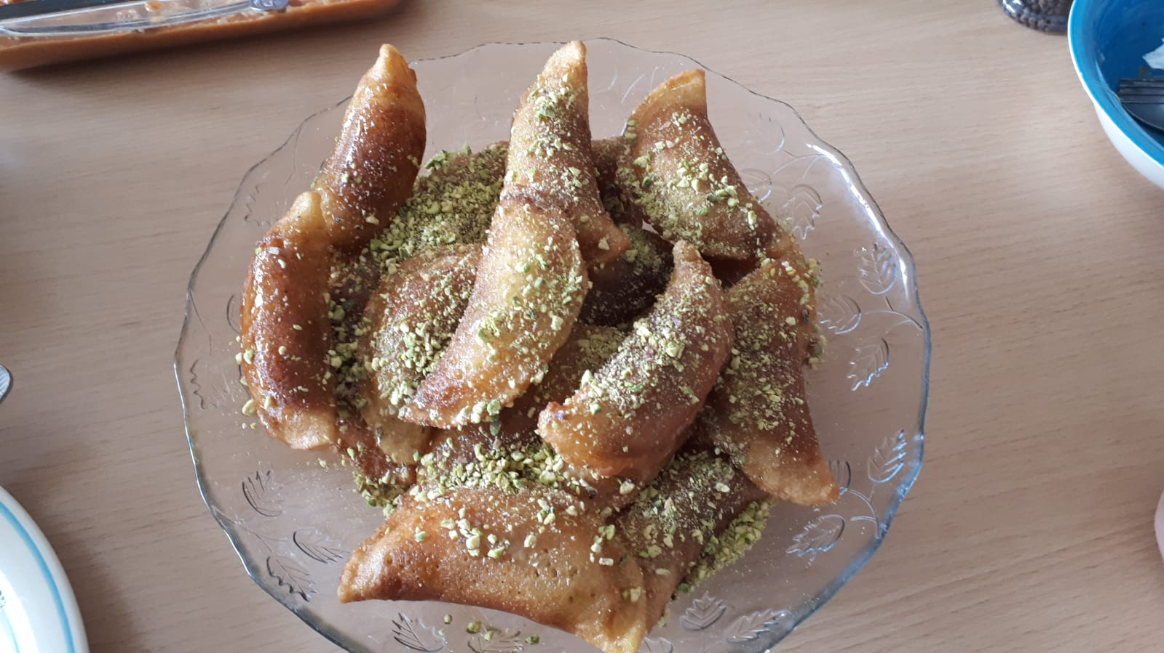
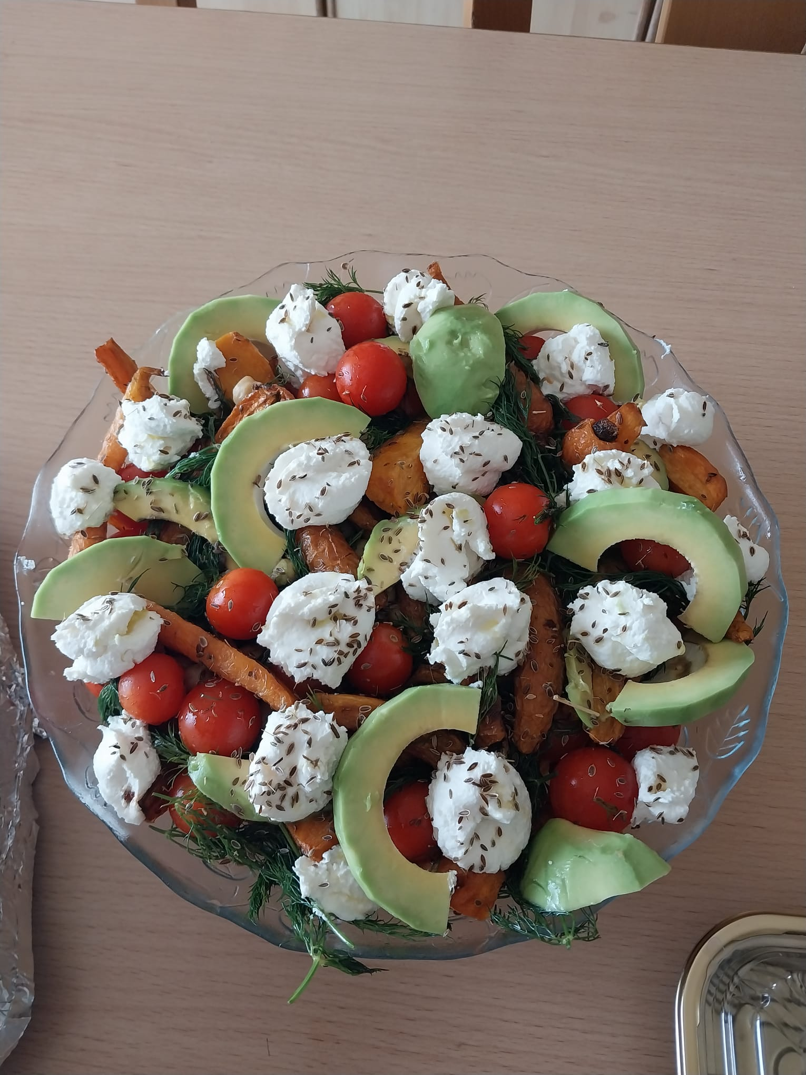
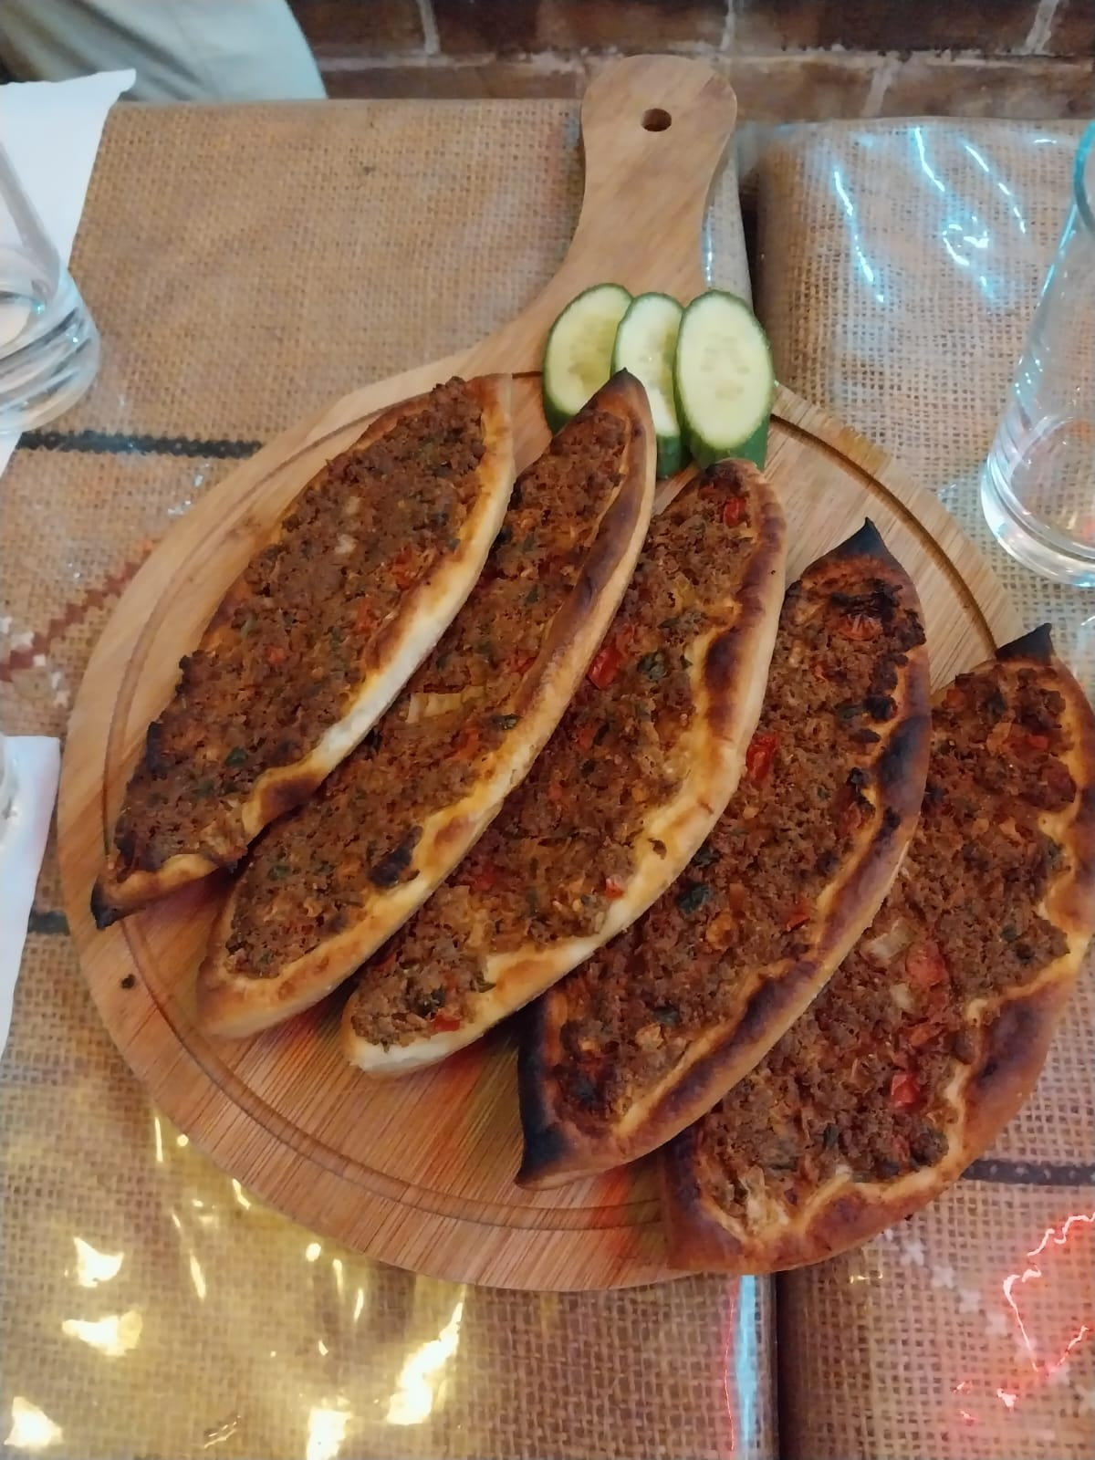
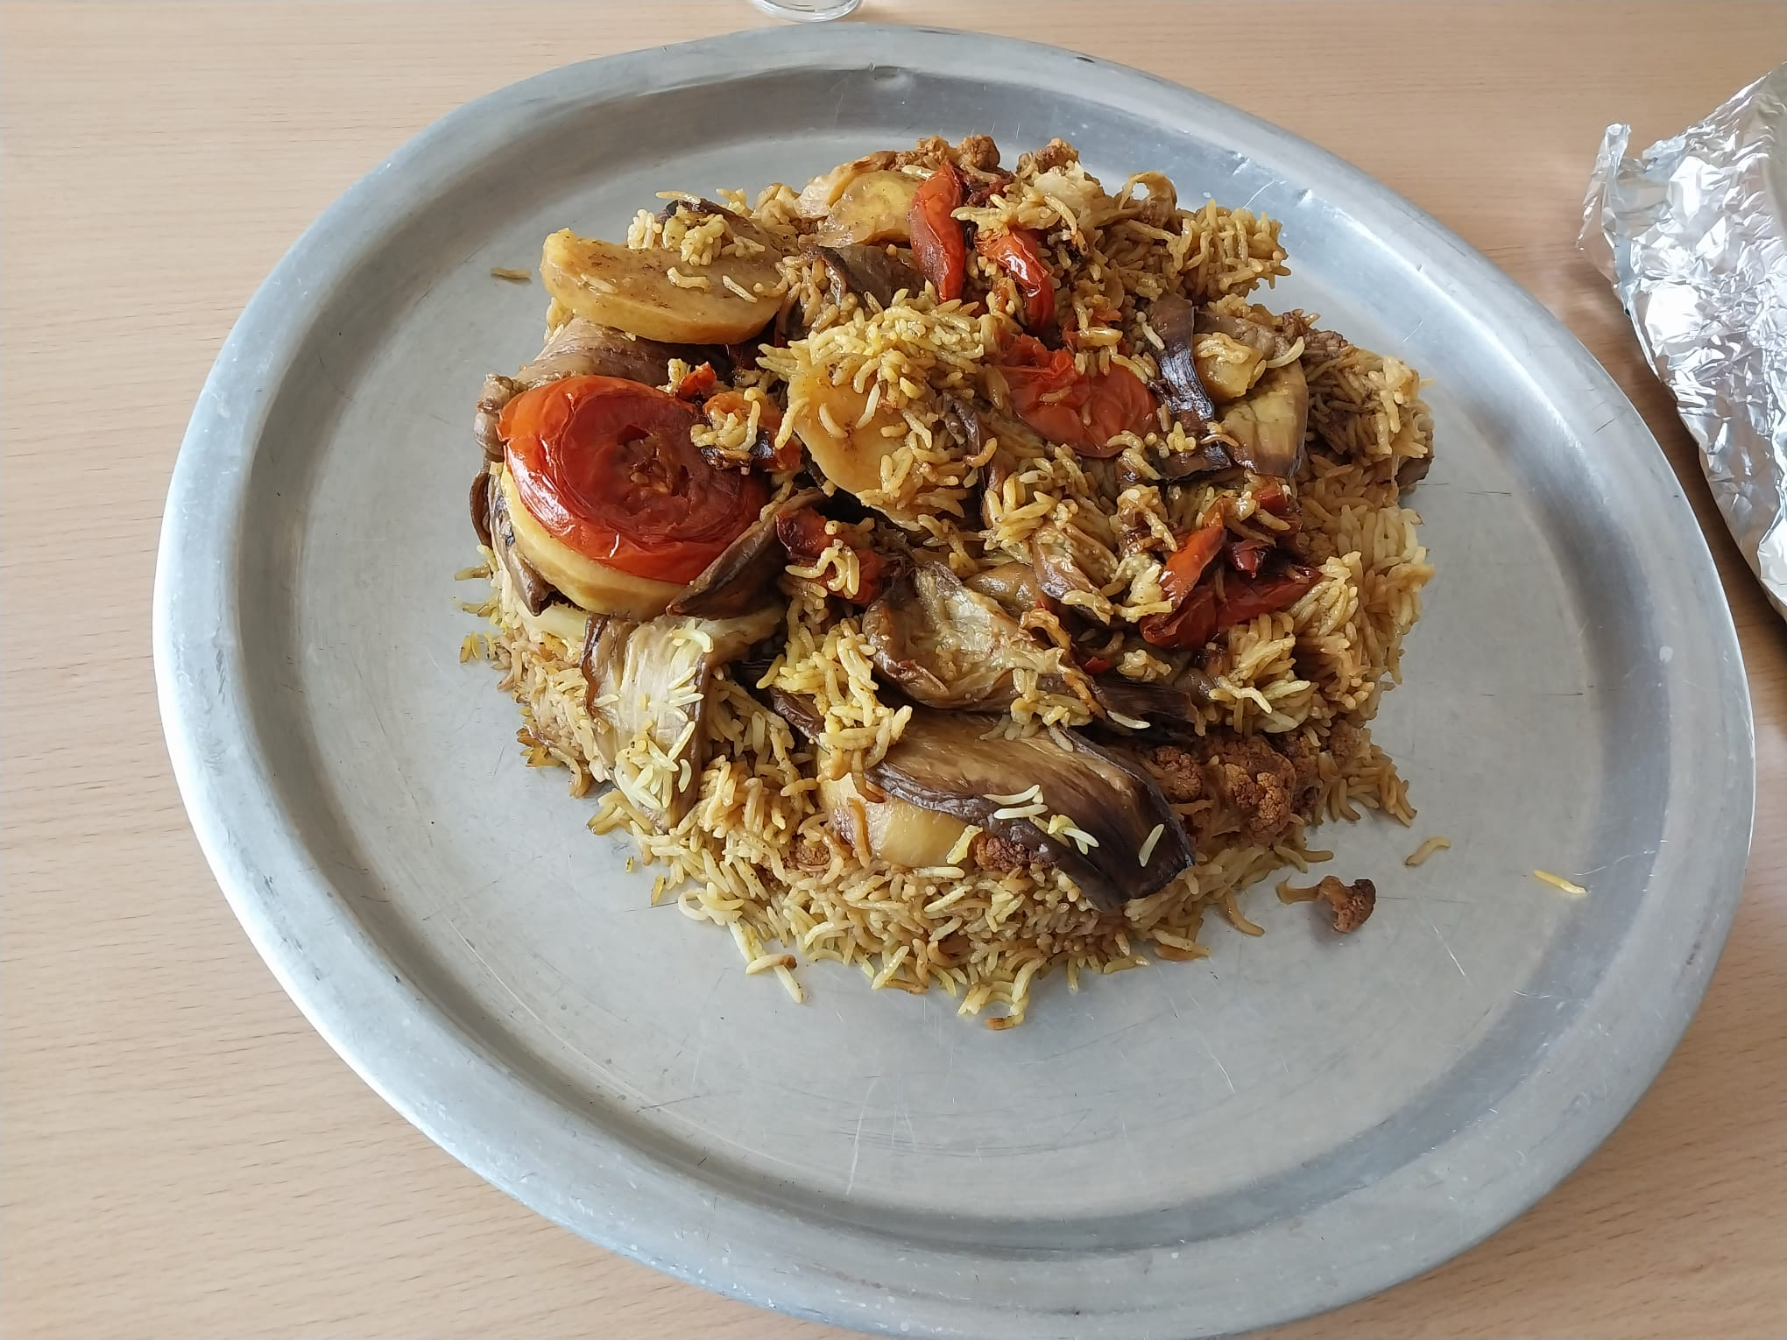
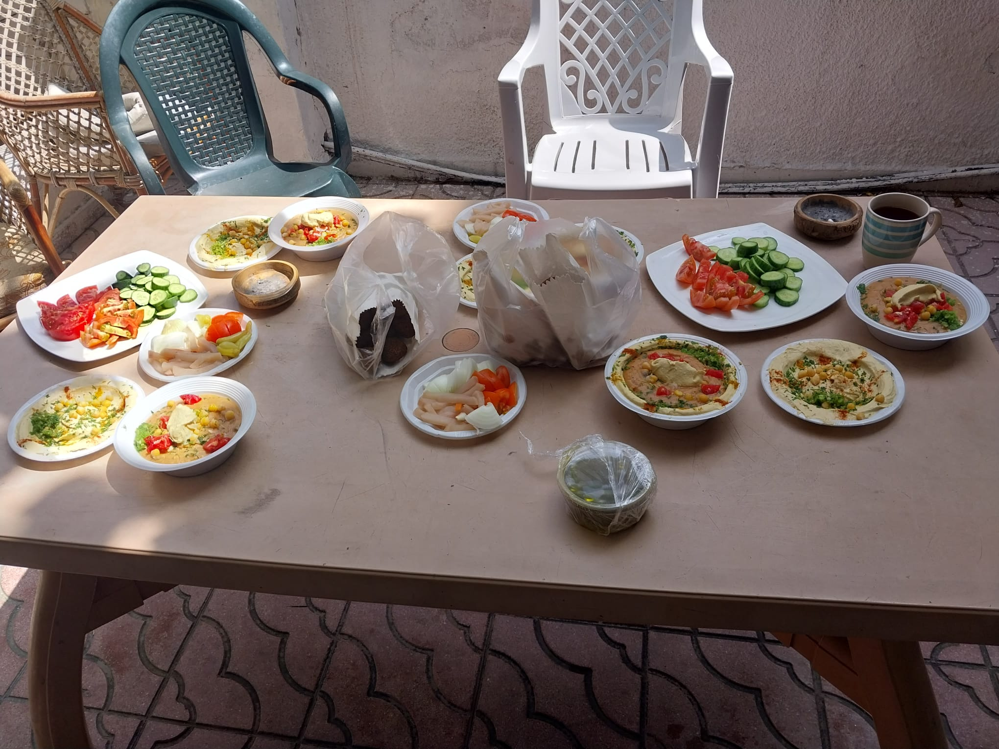
Gaza è cibo

Slide 8
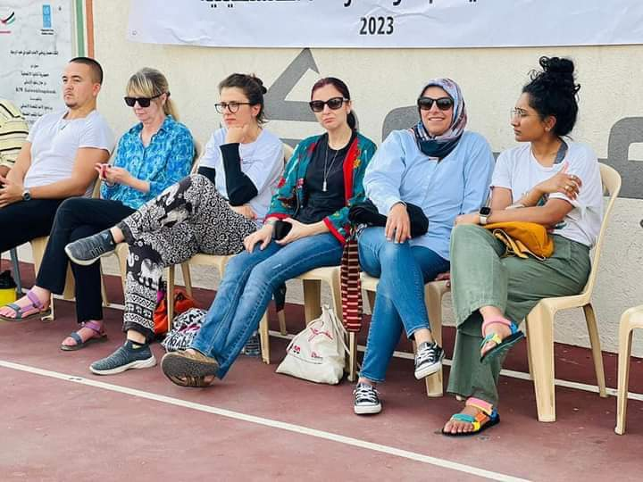
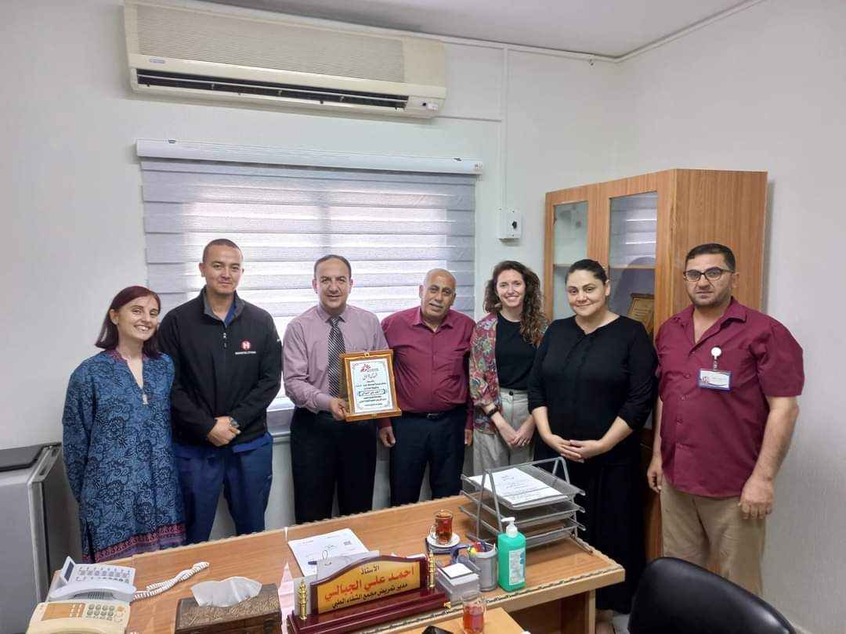
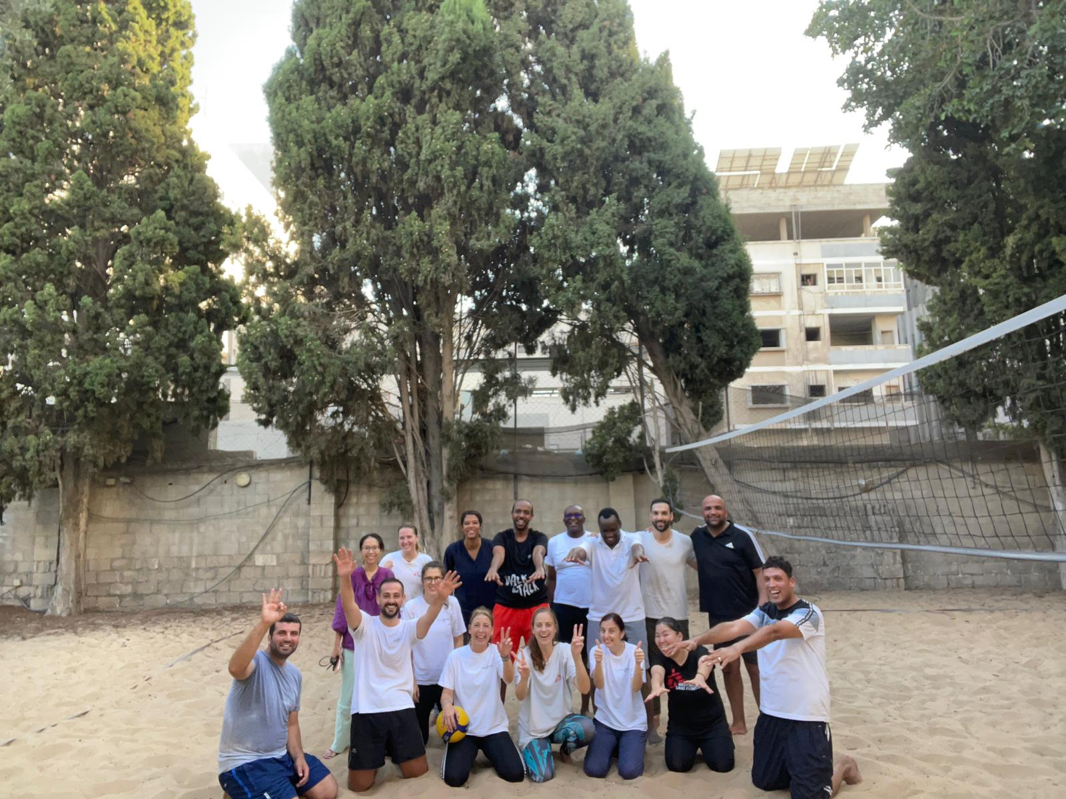
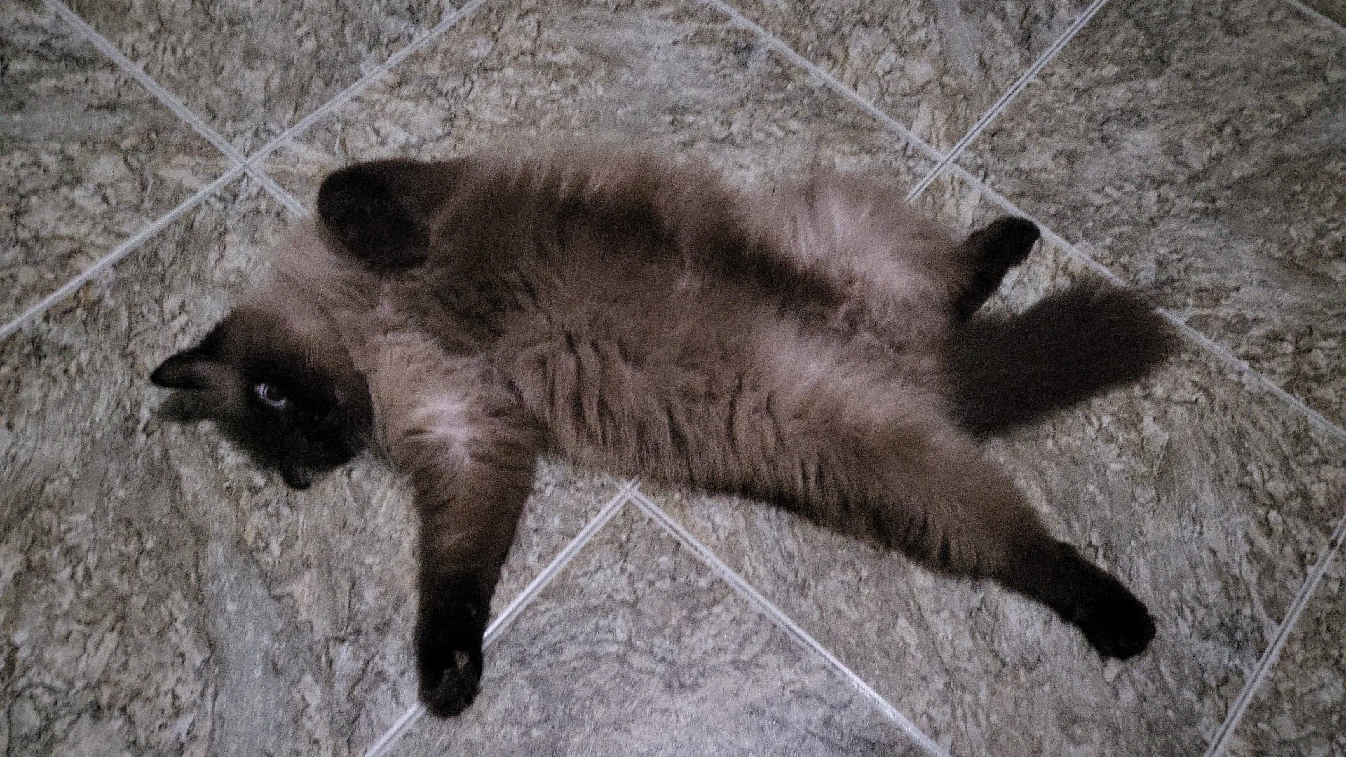
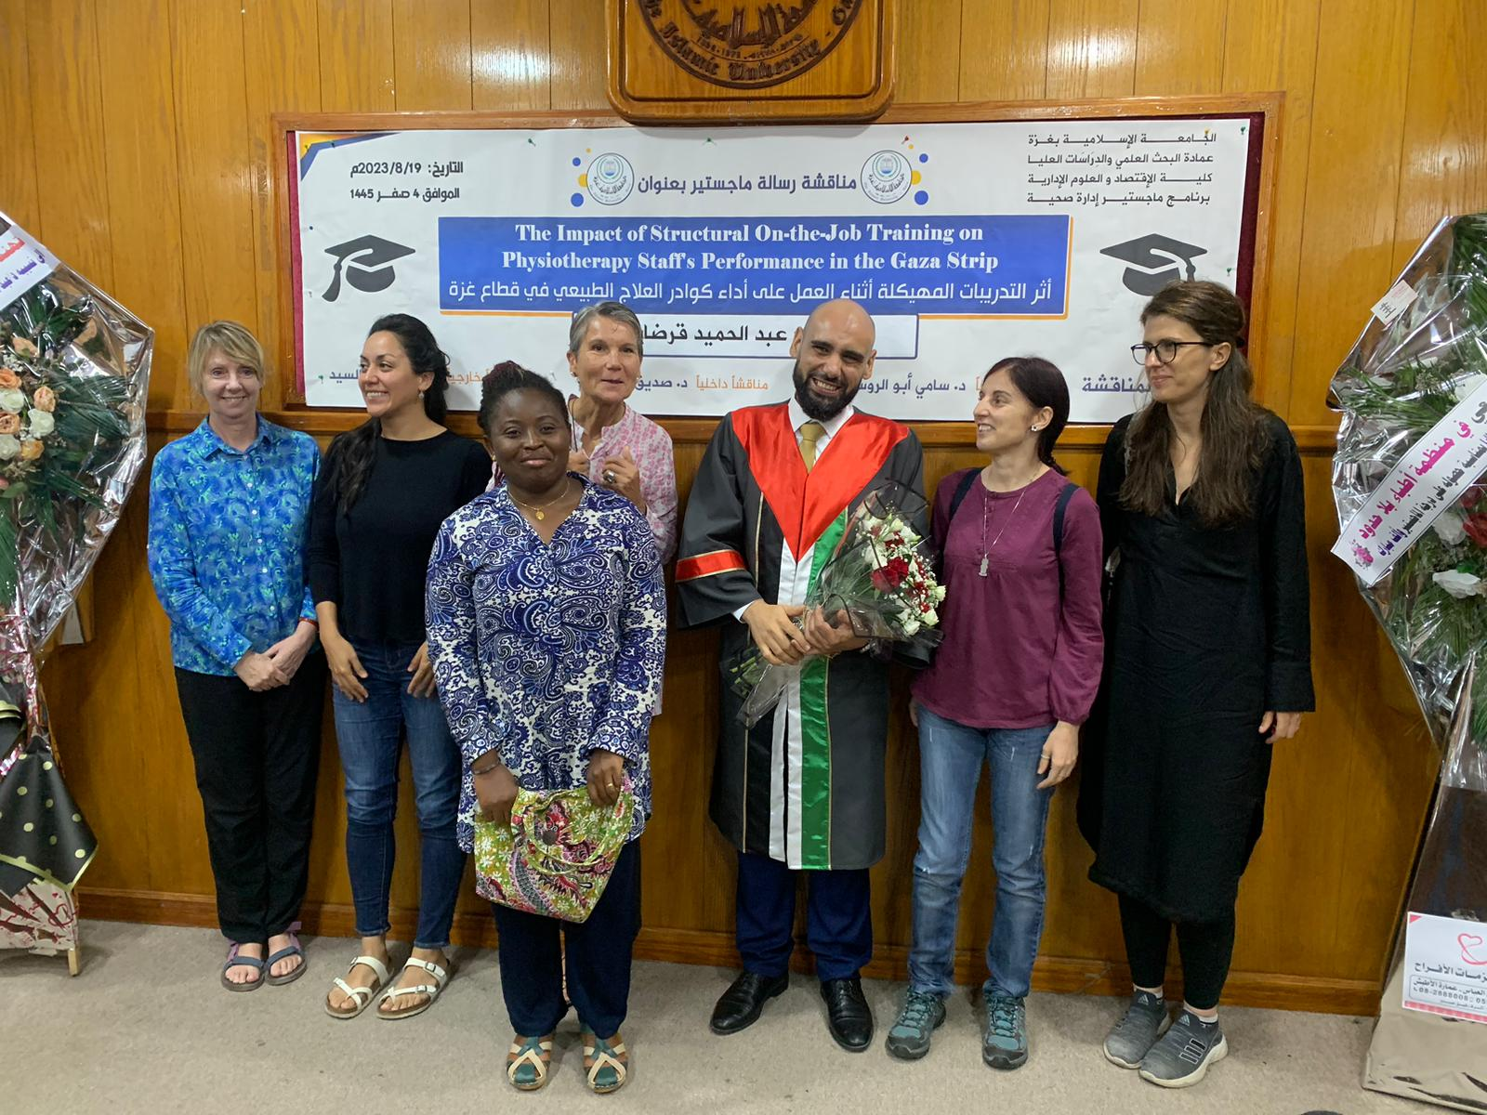
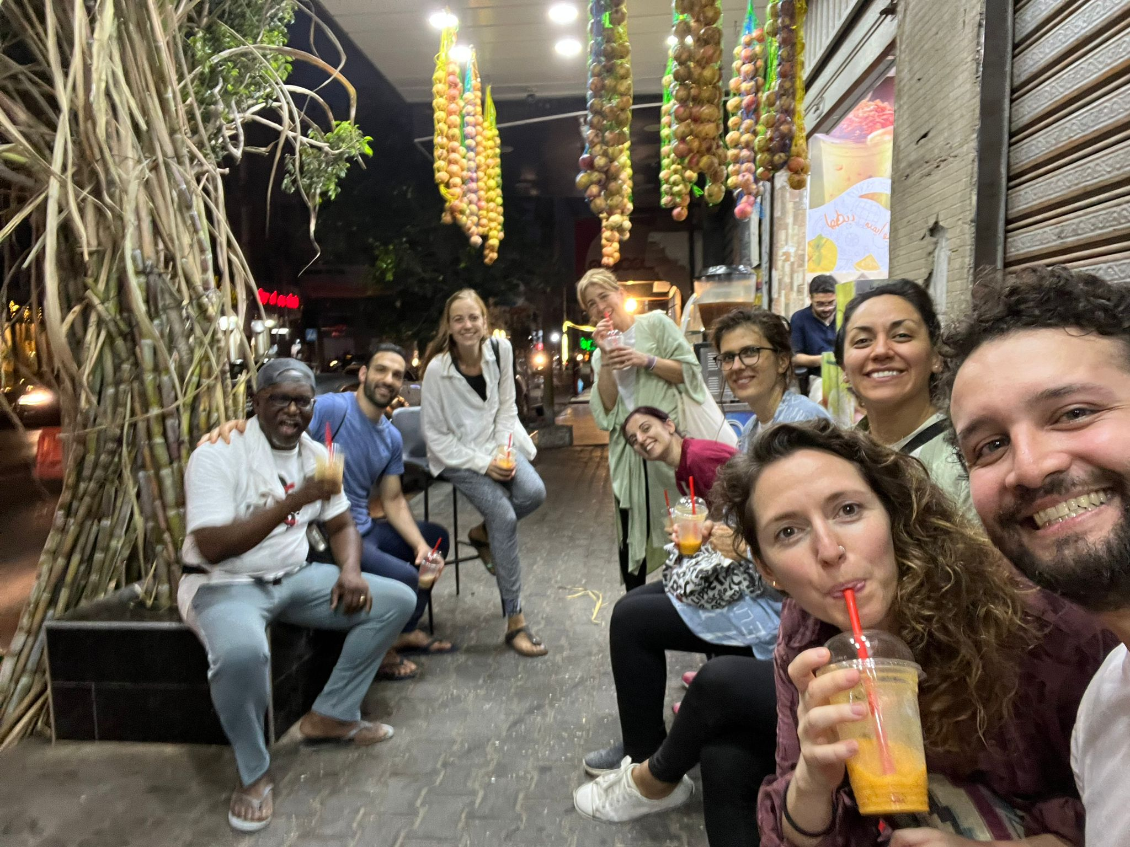
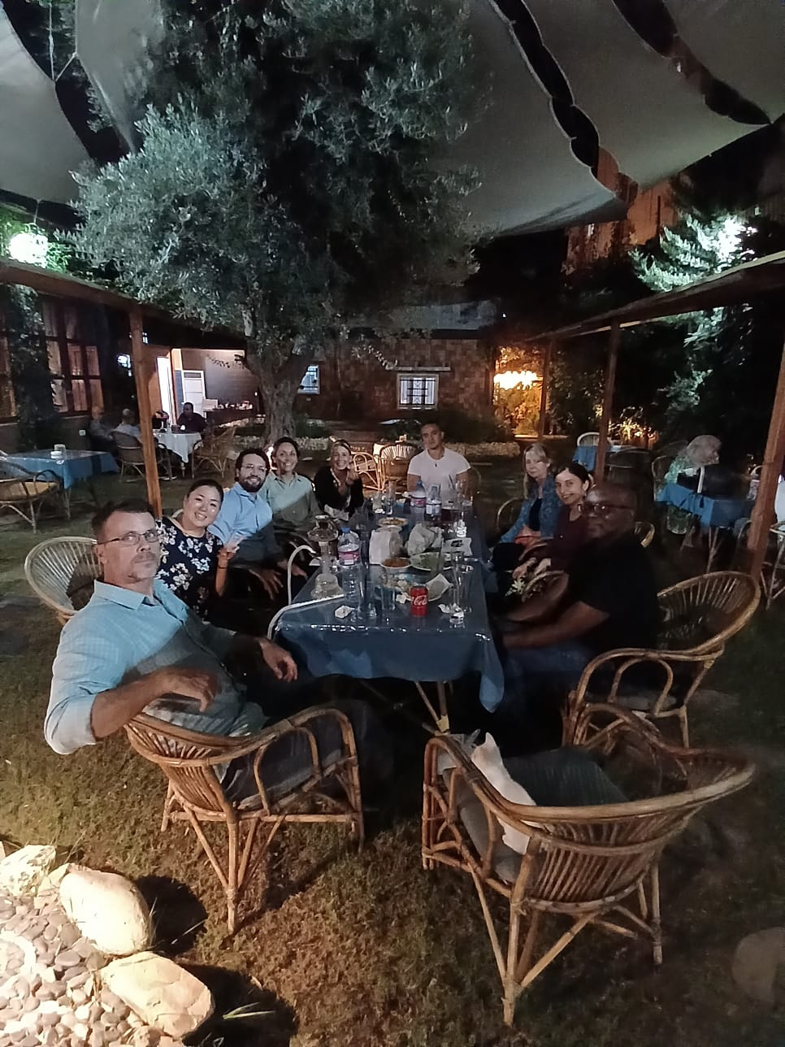
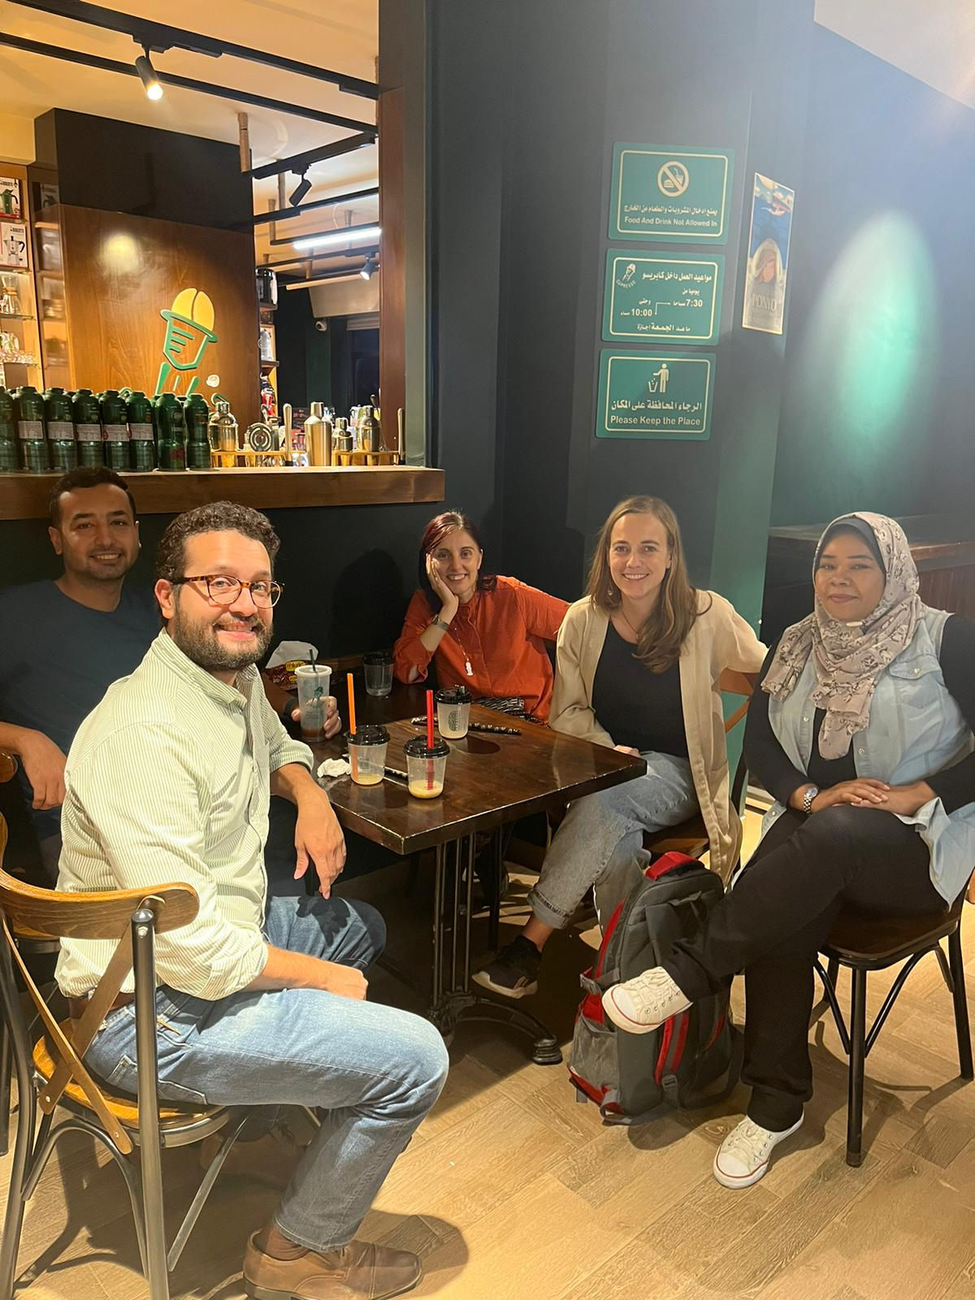
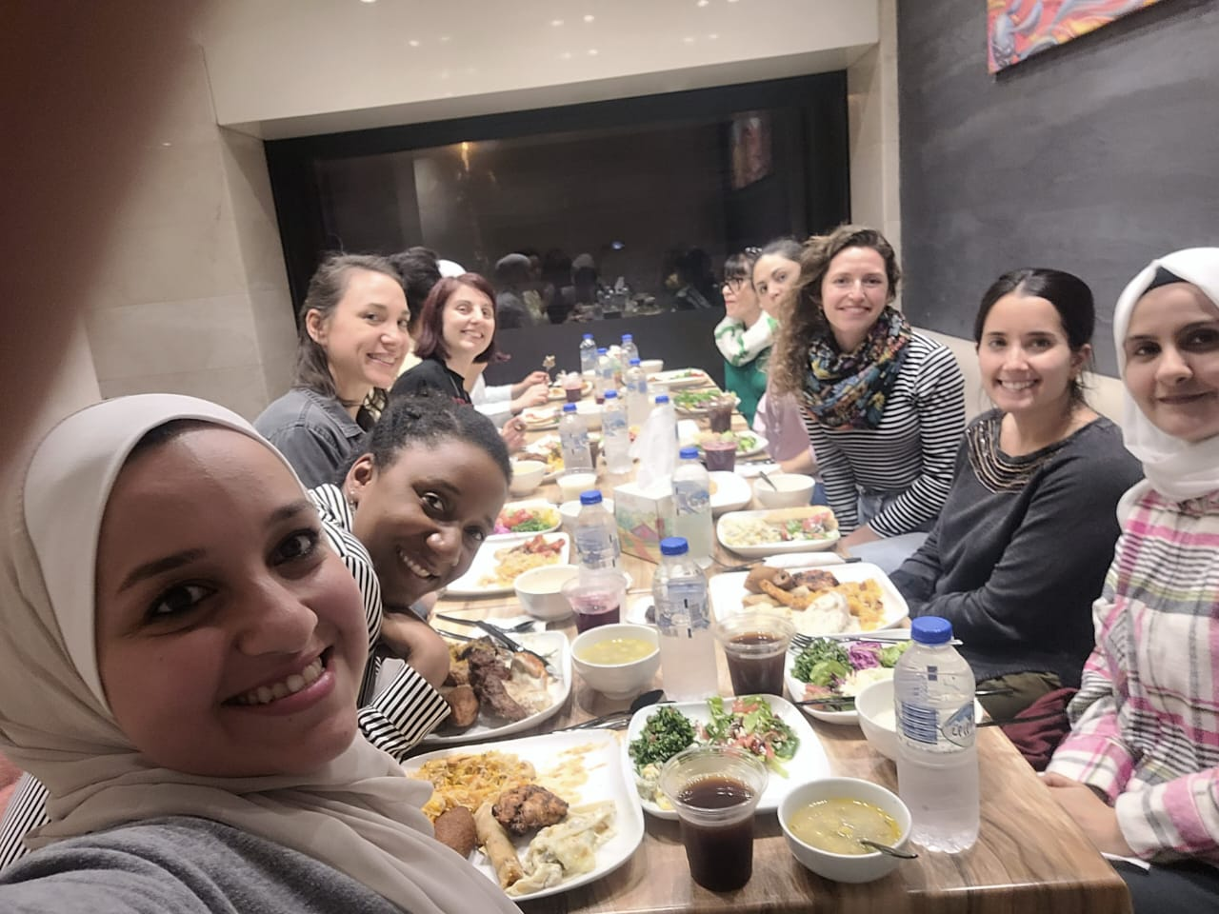
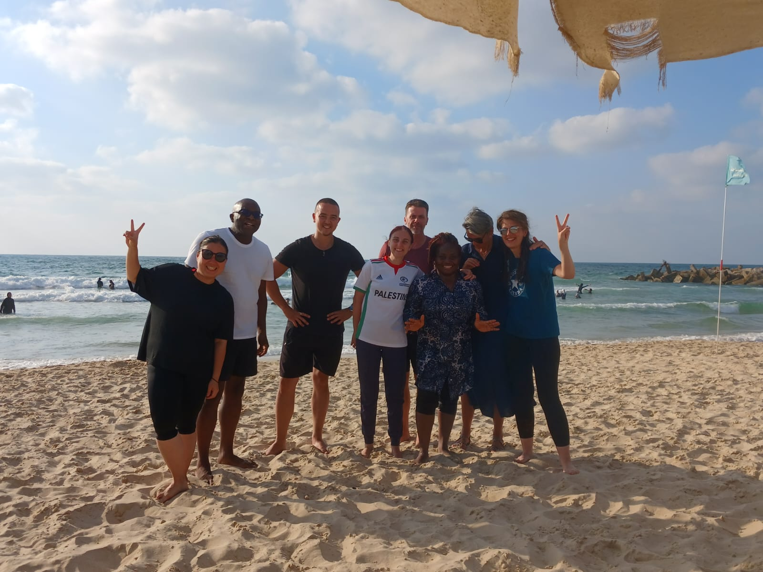
Gaza è quotidianità

Slide 9
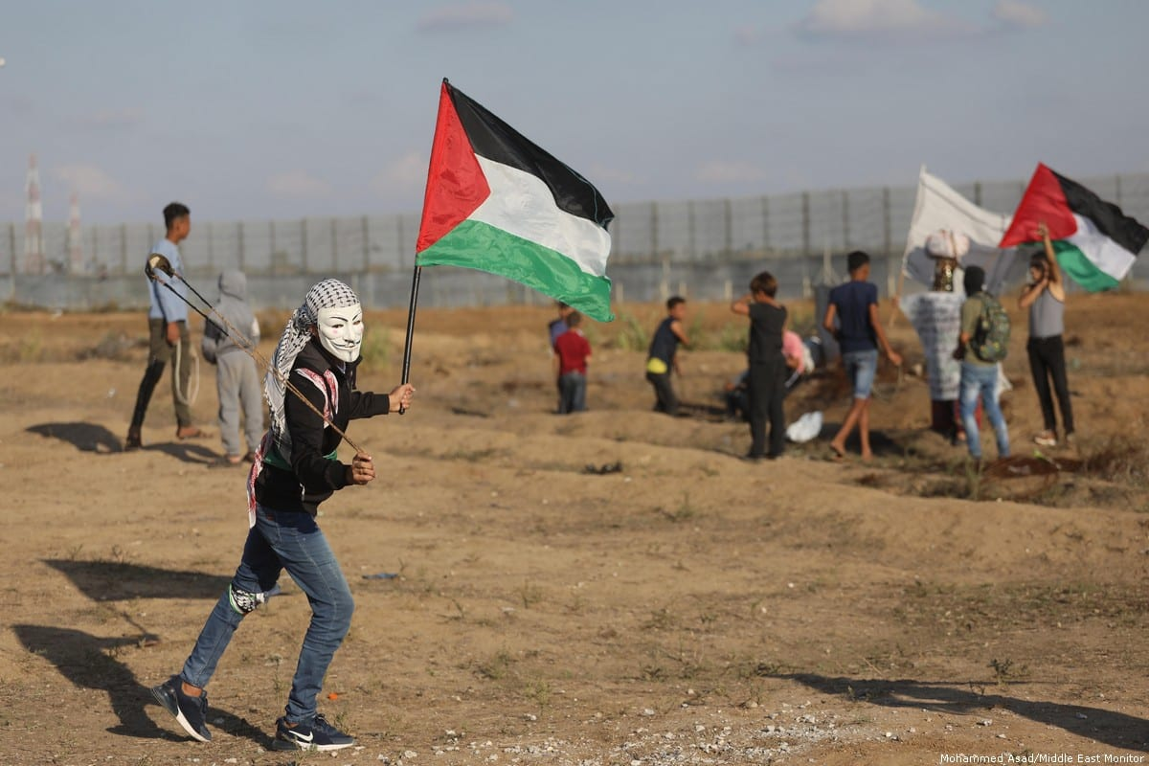
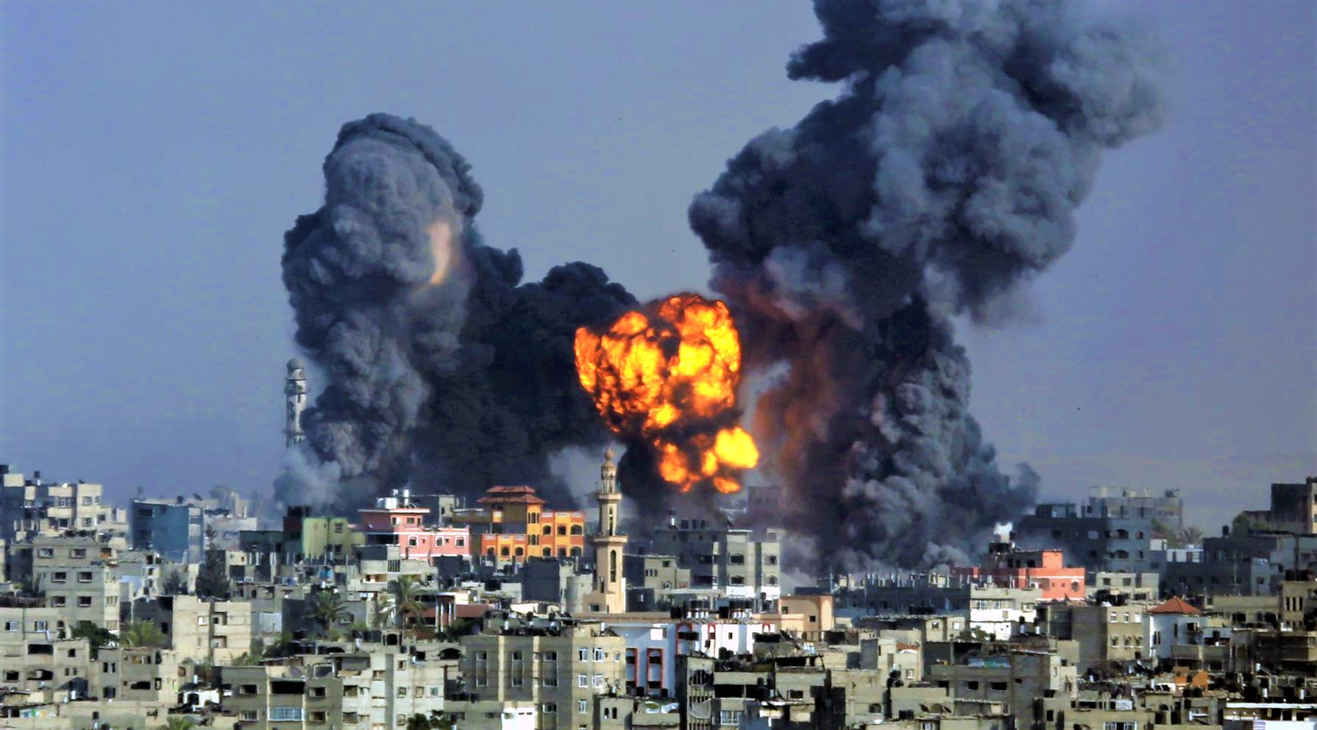
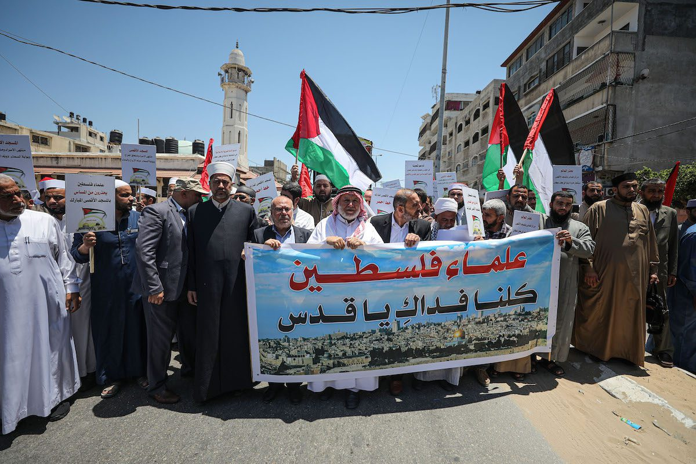
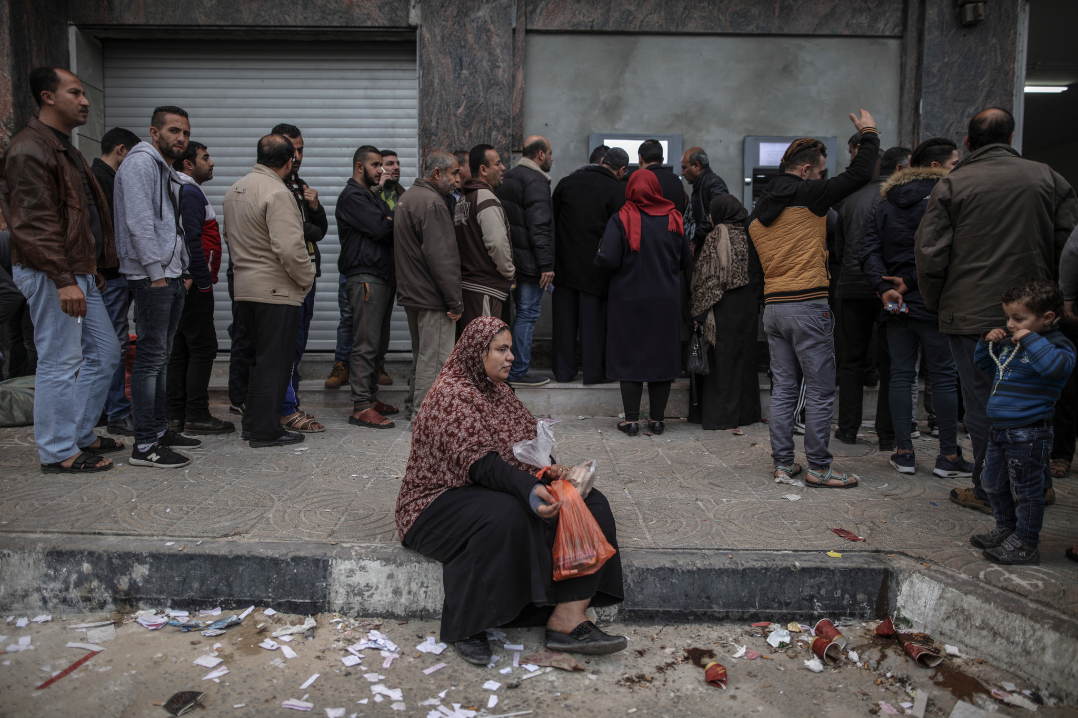
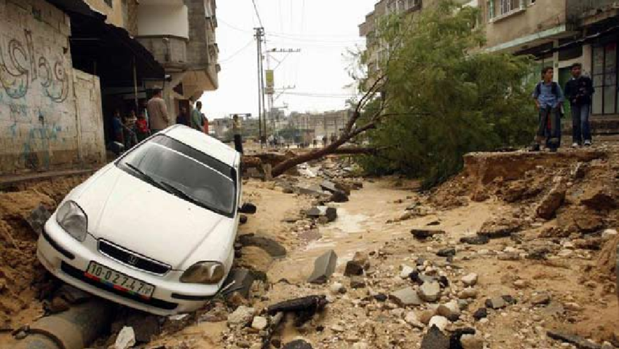
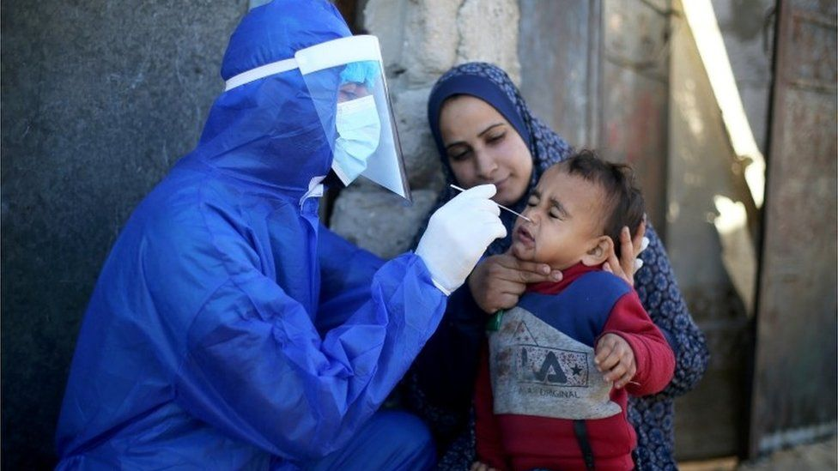
Situazioni profondamente anormali in Gaza
Scenario 1: Fences and Demonstrations
Scenario 2: Open War Israeli-Palestinian Conflict
Scenario 3: Internal Palestinian Conflict
Scenario 4: Economic Crisis
Scenario 5: Natural Disaster
Scenario 6: Epidemic

Slide 10
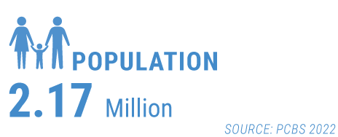
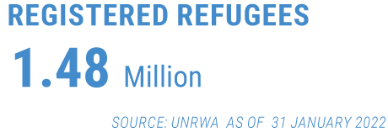
General Context
Palestine refugees for 365 km2 -Density 4,986 inhabitants /km2 (May 2021)
70% of total Gaza Population is consist of Refugees
80 % of the population dependent on international assistance, average unemployment rate stood at 47 %.
50% of people are under 18 and 70% under 30

Slide 11
General Context
High aid dependency and high reliance on negative coping mechanisms
Although the severity of core sectoral needs may at a superficial glance appear relatively low, aid dependency in Gaza is extremely high and creates a very fragile state of stability. Similarly, even though a relatively large number of households appears to be meeting their very basic needs, a high percentage of them (including aid-recipient households) are employing negative coping mechanisms (e.g. taking on debt) in order to meet their most basic needs, thereby further exacerbating their vulnerabilities.
oPt: Multi-Sectoral Needs Assessment (MSNA) Key Sectoral Findings - Gaza (July 2022)

Slide 12
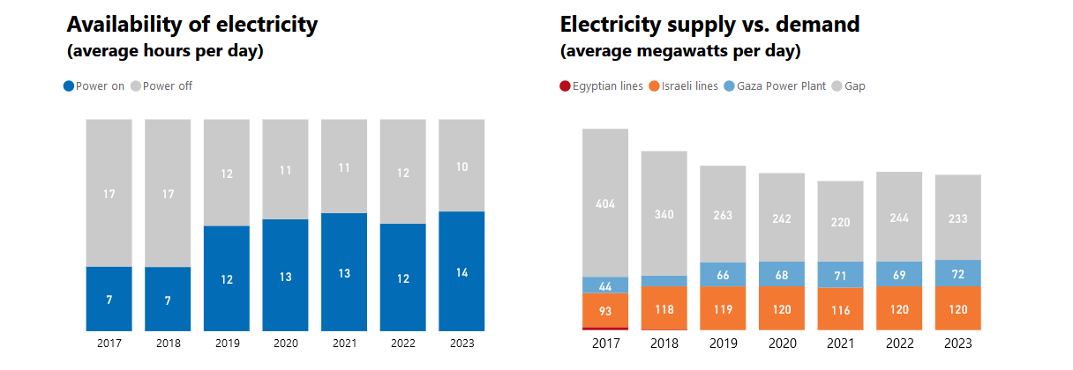
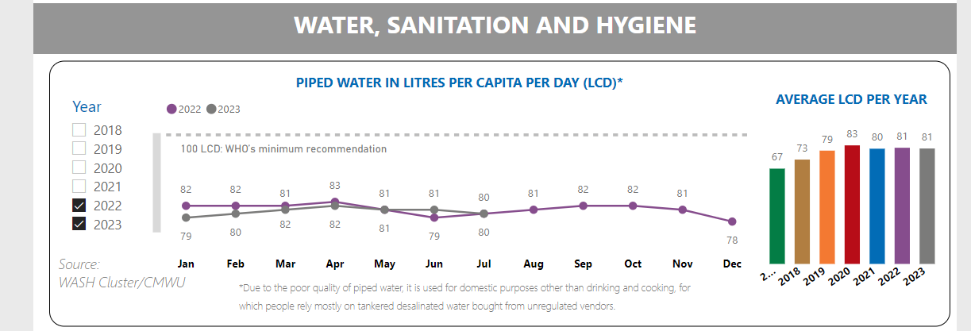
General Context
Majority in Gaza Strip do not have Access to clean water.
Availability of electricity varies during the year from 10 to 14 hours
General deterioration in living conditions and the potential for an increase in violence, including an escalation of hostilities in Gaza.

Slide 13
Most recent escalations

Slide 14
General Context
Socio economic situation
Food security in Gaza has deteriorated with 63 per cent of people in the Gaza Strip being food insecure and dependent on international assistance. 81.5 per cent of the population are living in poverty, overall unemployment rate is 46.6 per cent (48.1 per cent for Palestine Refugees living in the camps), and an unemployment rate of 62.3 per cent among youth (15-29 years, refugees and non-refugees). Particularly concerning is the unemployment rate for women in Gaza, which stands at 66.3 per cent (compared with 23.9 per cent in the West Bank). Additionally, 88 per cent of private sector employees in Gaza earn wages below the minimum, with an average monthly income of NIS 722.
Several thousand people took the streets across the Gaza Strip on July 30th to protest chronic power outages and difficult living conditions, providing a rare public show of discontent. Hamas security forces quickly dispersed the gatherings. The demonstrations were organized by a grassroots online movement called “alvirus alsakher,” or “the mocking virus”.

Slide 15
Context and Perspectives Pre-Oct 7
Power still in the hand of the Defacto Authorities of Hamas, they are losing popularity in Gaza.
More Taxes imposed by Hamas Authorities
Youth desperate ➔ more are trying to immigrate (19,000 applied for a Turkish visa in July 2023). Protests at the fence
Egypt, UN, Qatar as a key stakeholder in the Israel and Palestinian factions' discussions
Tension in WB/Jerusalem can trigger another escalation but by other Faction such the last escalations- in August 2022 and May 2023 with PIJ
Due to budget shortages, ICRC announced in April the closure of the office in Khan Younis.: decision to decrease the operations costs, including the closure of offices and laying off employees, but to maintain the same level of support and assistance for people in the target areas.
WFP suspended assistance to over 200,000 people, which is 60 percent of its current case load, from June.
Over the past years, UNRWA went through several financial crises that affected its provision of services due to lack of funding.
Last June UNRWA warned that its services are at risk of suspension amid continued lack of funding.

Slide 16
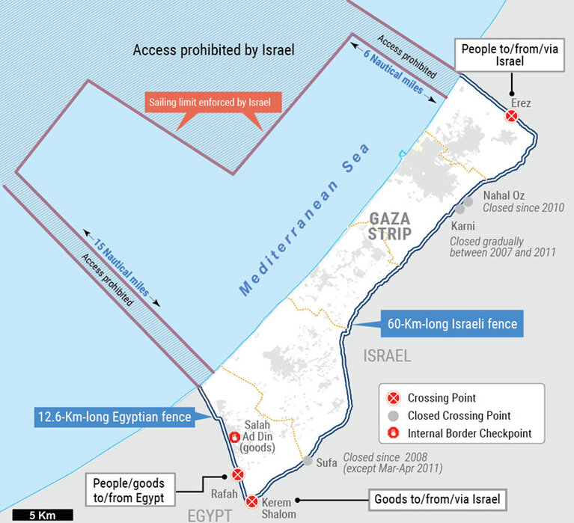
Access and Movements
In July, Erez recorded the highest number of people’s exits since at least 2004. The Israeli authorities allowed 67,769 exits of people from Gaza. Exits were about 90 per cent higher than the monthly average in 2022. The overall number of exit permits for such purposes decreased from 22,219 in June to 21,970 in July.
81% of permit application per patients approved in July (but only 49% for caregivers). In July, 80 (M: 58; F: 22) patients from the Gaza Strip were requested for interrogation as a prerequisite
to their permit applications, the highest monthly number in six year
RAFAH
Truckloads of aid continue to enter
More facilities to import food, Fuel, building Material and medicines from Egypt
KAREM SHALOM
Release of intensification of restrictions for more than a year.
More goods entered and exited Gaza compared to the previous months.

Slide 17
Evolution since last year
No sign of implementation of a “unity government” : 2 MOHs functioning separately
Musical Chairs at the key positions of Gaza MOH (ICD, directions of hospitals, CDS) but still they are member of the party.
Pending Issue of the MoH Staff’s salaries that are not fully paid impacting on the motivation and attendance of the teams ( 50 % of the salaries usually paid late )
We have seen the World Bank arriving to Gaza and visiting many locations in the strip and visiting Many Hospitals in Gaza Strip they were received by the Deputy Minister Dr Abu Al Rich
We must mention that it’s the first time since 2007 that the MOH/Gaza was invited officially to attend a conferences/trainings in Egypt Cairo.

Slide 18
Healthcare in Gaza
Healthcare facilities across the Gaza Strip, lack adequate infrastructure, training opportunities and experience frequent power cuts. Essentials medical supply is inadequate, and ruptures are often prolonged. The services provided are overstretched due to years of socioeconomic decline, conflict, and closure.

Slide 19
Health Situation in Gaza
During normal situation, access to health care is available but it is usually weak during emergencies.
Advanced care services remains a real challenge faced by the health care system in Gaza.
Infant mortality rate 6.6 of deaths per 1,000 live births (Annual Report 2022. MoH – Gaza Strip)
Vaccination coverage (EPI) 98%
Life expectancy 72-male / 75-female
Fertility rate, 3.32 children per women
High food insecurity 63%
Inadequate provision of clean water and sanitation
More than half of the adult population in the West Bank and Gaza screen positive for depression. In Gaza specifically, the rate climbs to 71%.
Noncommunicable diseases such as diabetes, hypertension, cardiovascular disease (CVD) and cancer are replacing communicable diseases as the main causes of morbidity and mortality

Slide 20
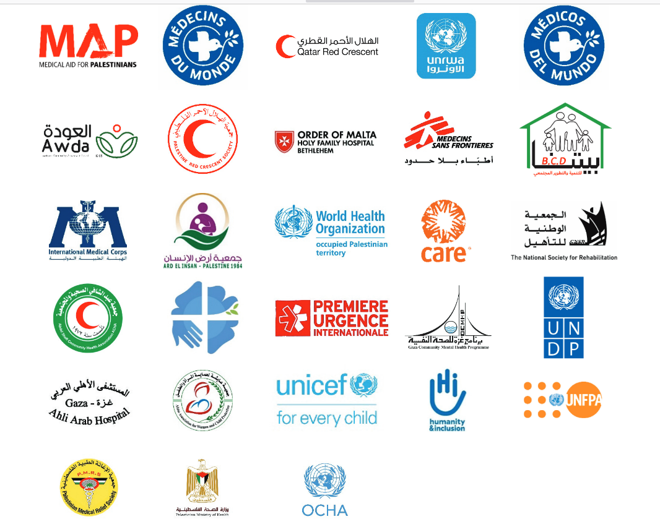
Health situation in Gaza
Medical Facilities
TOTAL of 159 Primary Health Care Clinics and 35 Hospitals
22 PHCs - UNRWA covering 70% of the total population
52 MOH PHCs and 5 Military Clinics
35 hospitals – 13 MOH , 2 military, 20 NGOs and privates. 3,412 bed capacity
80 NGOs and private
Notes:
Cosa facevo io? Ustioni e traumi da conflitto.
Strutture del MoH (tranne una). Collaborazione con MoH.
Importazione medicinali, macchinari etc.
Training/accompagnamento dello staff MoH su tecniche e protocolli.
Ristrutturazione strutture sanitarie.

Slide 21
Barriere all’azione umanitaria
ATTORI INTERNAZIONALI
2018 gli USA – come misura punitiva verso l’Autorità Palestinese che rifiutava di riconoscere Gerusalemme come capitale di Israele – decisero di togliere i finanziamenti a UNRWA (aiuto umanitario come strumento di pressione)
Boicottaggio internazionale contro il governo di Hamas in Gaza e leggi di contro terrorismo hanno portato molte ONG a ritirarsi dalla striscia di Gaza perché è impossibile lavorare senza avere contatti con Hamas.
ISRAELE
Impossibilità di accesso per alcuni operatori umanitari in base alla loro nazionalità o – spesso –al nome.
Impossibilità difficoltà di movimento dentro/fuori Gaza sia per i Gazawi che per i Palestinesi in genere.
Ingresso di materiali soggetto a ban. Lista delle restrizioni non pubblica e non fissa.
DFA
Restrizioni nel tipo di attività possibili (no Salute Mentale)
Clima di sospetto e controllo continuo
Controllo sui movimenti in/out sia dello staff nazionale che internazionale («collaborazionisti israeliani»)
Notes:
Quando parliamo di azione umanitaria dobbiamo ricordare che abbiamo bisogno di uno spazio (sia fisico che legislativo) per agire, di persone e di fondi.

Slide 22
Azione umanitaria a Gaza oggi: è possibile lavorare con un conflitto in corso?
Notes:
Troppo pericoloso
Distruzione delle strutture
Quantità limitate di aiuto
Azioni limitate che sono rese possibili dal coraggio e dalla abnegazione del personale.
L’IMPORTANZA DELLA TESTIMONIANZA (usare un linguaggio chiaro (l’importanza delle parole), non aggressivo ma specifico)

Slide 23
THANK YOU
Grazie
شكرًا

